Slide 1
About CLA
Our Independent Spirit

Slide 2
Sharing Our Story
The CLA Promise

Slide 3
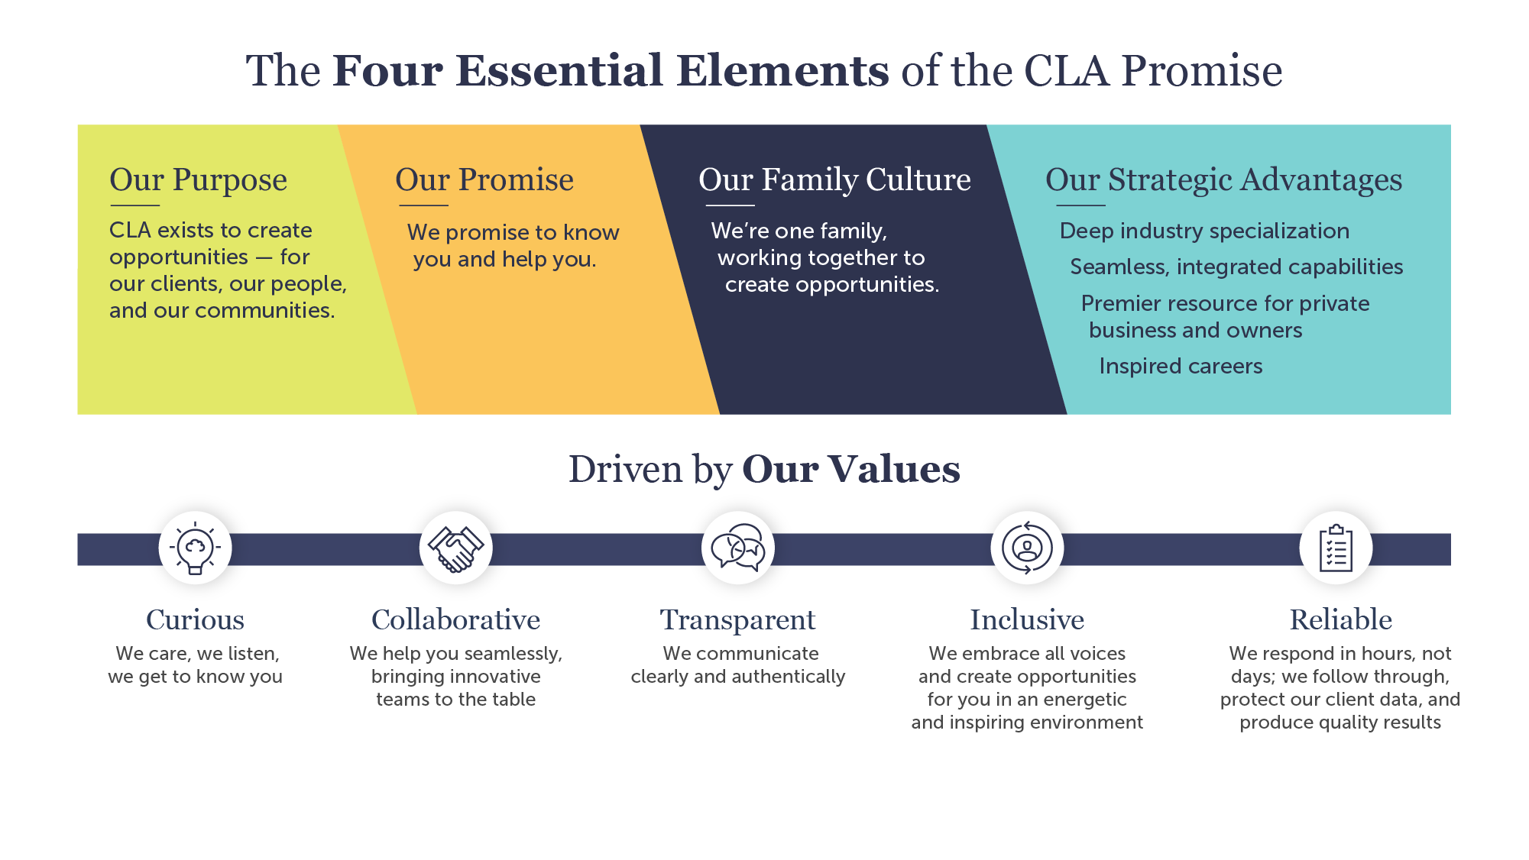
3

Slide 4
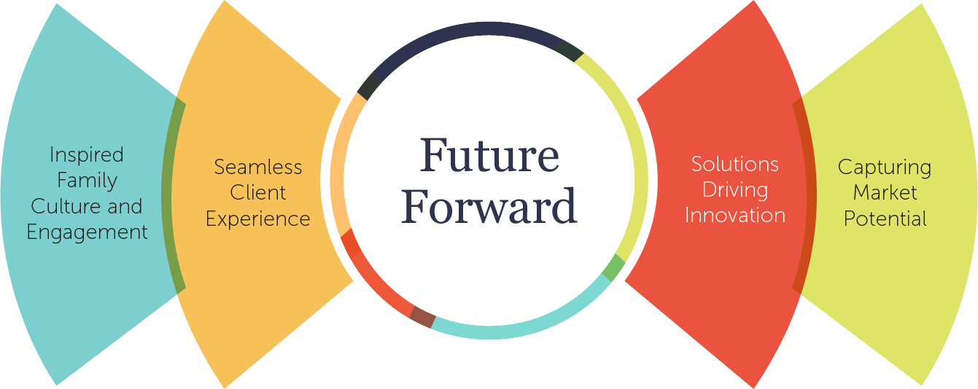
CLA Accelerants

Slide 5
Why CLA?

Slide 6

Elevating the heroes of Main Street
SERVING HEARTBEAT OF AMERICA
Resilient economy and community vitality
LOCALLY EMPOWERED
Connected, collaborative local leadership
130 locations, no central headquarters
$13B RIA + largest back-office accounting and payroll
Nationally recognized for female leadership
INTEGRATED SERVICE MODEL
Seamless wealth, tax, and business advisory
NEXT GEN LEADERSHIP
GenX and millennial led, succession-minded
Investing $500M
Shared service centers
DEMOCRATIZING AI
Advanced generative AI for clients and CLA family
U.S. BUILT
U.S.-based talent, local jobs, no offshoring
Aiming for $10M CLA Foundation
ELEVATING PEOPLE AND COMMUNITIES
Connection centers, pathways to prosperity
STEWARDS OF OUR PARTNERSHIP
100+ year legacy, self-funded, independent
8th generation of ownership

Slide 7
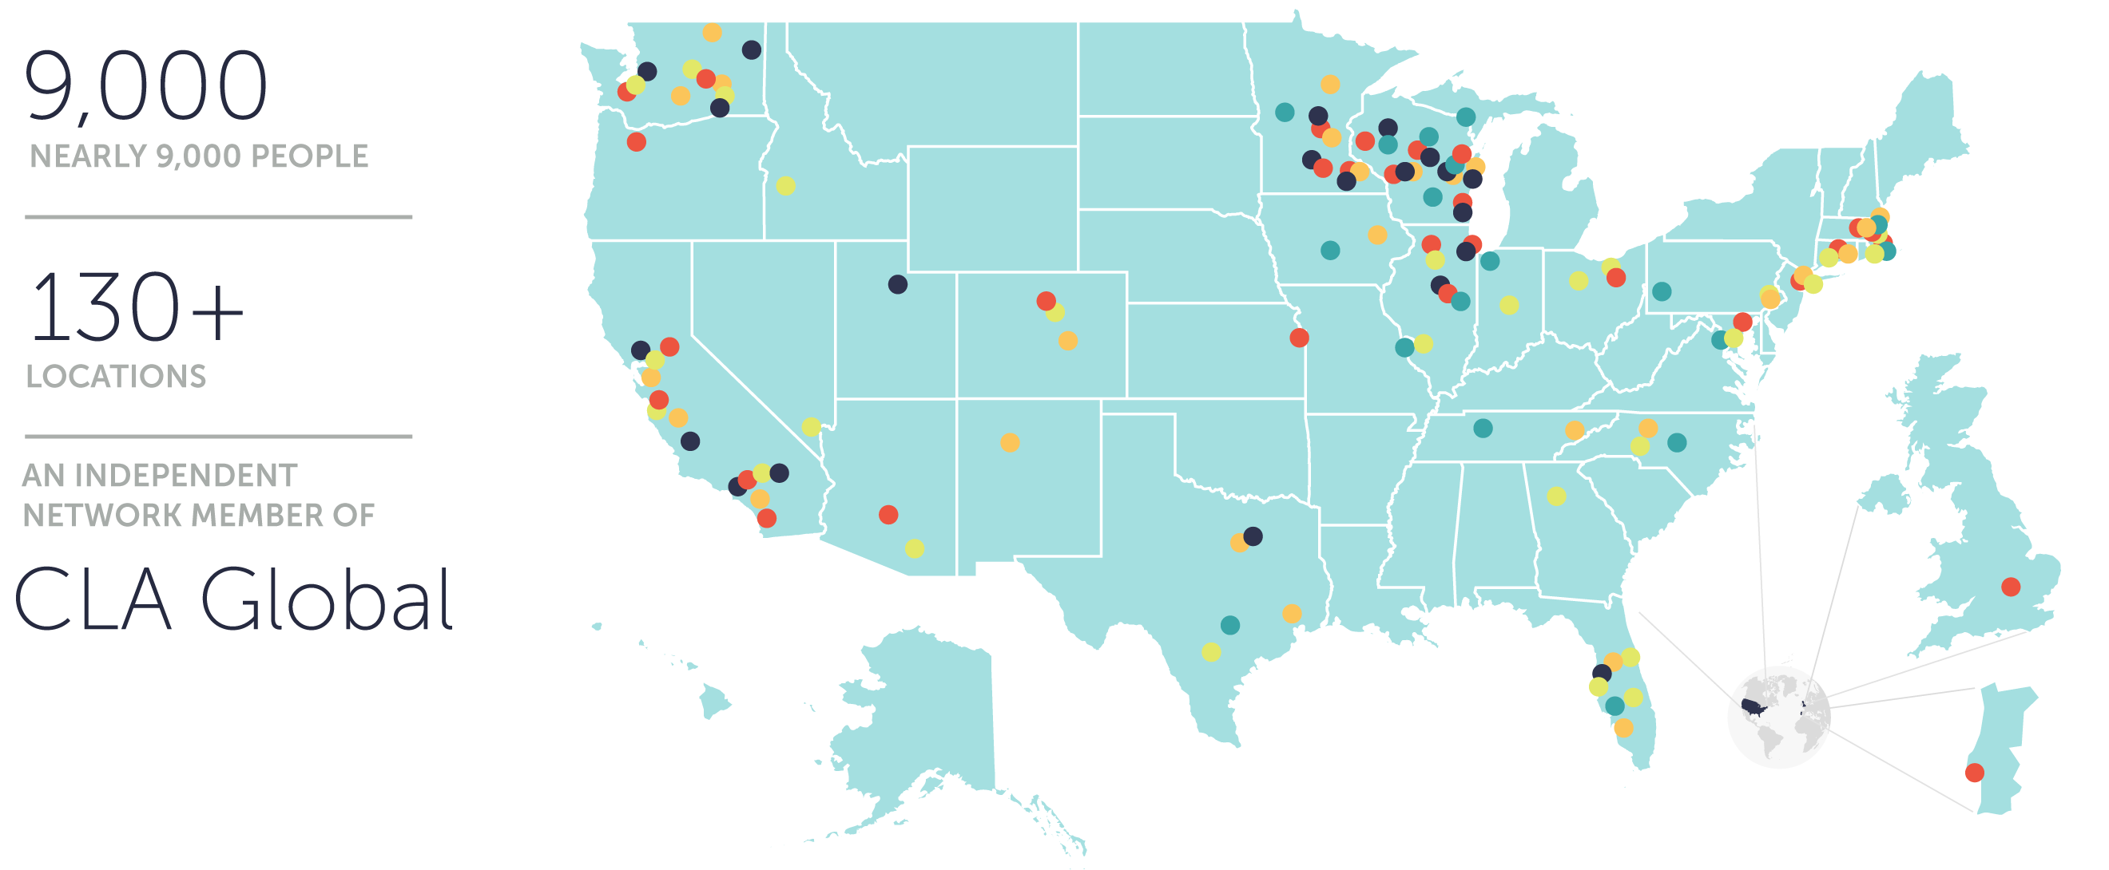
National and International Reach
CLA (CliftonLarsonAllen LLP) is an independent network member of CLA Global. See CLAglobal.com/disclaimer.

Slide 8














Agribusiness, food, and beverage
Construction
Education
Financial services
Government
Health care and life science
Logistics
Manufacturing
Nonprofit
Private equity
Professional services
Real estate
Retail, dealerships, and hospitality
Technology
Deep industry specialization

Slide 9





Services That Create Opportunities
Wealth Advisory
Digital
Audit
Tax
Consulting and Outsourcing

Slide 10
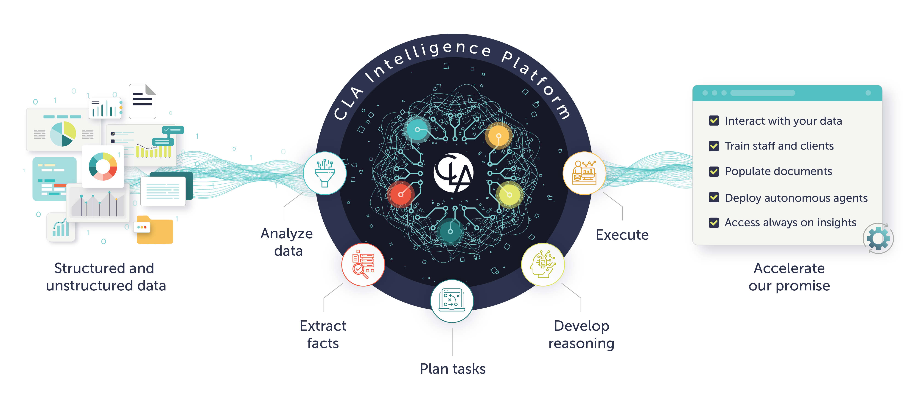

Slide 11

Impeccable Client Service™
Consistently exceeding client expectations and delivering exceptional experiences at every touchpoint.
We’ll know when we’ve delivered it through:
The voices of our clients
The voices of our people

Slide 12
2024 Top 100 Firms: Accounting Today
Rank | Firm | Headquarters | Chief executive | Revenues (in $mn) | % chg. | Offices | Partners | Total employees
1 | Deloitte § | New York City | Jason Girzadas | $32,669.00 | 16.94 | 134 | 6,585 | 171,100
2 | PwC § | New York City | Tim Ryan | $22,750.00 | 9.74 | 76 | 4,037 | 75,000
3 | Ernst & Young § | New York City | Julie Boland | $21,460.00 | 12.30 | 90 | 3,700 | 55,900
4 | KPMG ^{§ 1} | New York City | Paul Knopp | $12,200.00 | 6.64 | 94 | 2,482 | 50,306
5 | RSM US ² | Chicago | Brian Becker | $3,885.38 | 8.07 | 81 | 1,180 | 17,085
6 | BDO USA | Chicago | Wayne Berson | $2,822.60 | 13.34 | 75+ | 860 | 12,212
7 | Grant Thornton ³ | Chicago | Seth Siegel | $2,362.18 | 2.24 | 47 | 595 | 10,114
8 | CLA ^{H} | NA | Jennifer Leary | $2,000.00 | 20.26 | 130 | 1,329 | 8,120
9 | Forvis ^{H} | NA | Tom Watson | $1,686.00 | 13.38 | 72 | 511 | 5,910
10 | Baker Tilly | Chicago | Jeff Ferro | $1,584.40 | 12.59 | 68 | 578 | 6,777
Key and notes: § Gross revenue *Firm estimate H Firm does not recognize a single headquarters location. NC No change NA Not available or not applicable
1 KPMG reports business offices only, not every physical location. 2 RSM US reports fee splits as both percentages (given here) and dollar figures. 3 Grant Thornton’s total personnel includes professionals in its India Service Center, based in Bangalore, India.

Slide 13
Leadership: Team of Teams
Chief Executive Officer
Jen Leary
Executive Leadership Team
Set vision and strategy
Senior Leadership Team
Maximize growth & Shape Client experience
Matrix
Leadership Team
Engage teams and drive results
Board of Directors
Young Executive Team

Slide 14




Why Others Have Decided to Join CLA
Our commitment to succession, building enterprise value and culture
Our professional services firm platform — integrated and not “eat what you kill”
wealth advisory, digital, audit, tax, consulting, and outsourcing
Our strong capital investment in innovation and building advisory
digital transformation, cybersecurity, solutions, data analytics
Our consistent, strong financial position
average owner income, AIV growth potential, fortress balance sheet

Slide 15
What Those Joining CLA Have Said
“Growth through seamless has been phenomenal.”
“I wish we had done this 10 years ago.”
“If I was only 40 when we came together with CLA.”
“There is no comparison where I am today vs. where I would have been at the legacy firm.”
“I wish I hadn’t taken the cash option and left more inside the firm.”
“The leadership opportunities have been outstanding.”

Slide 16
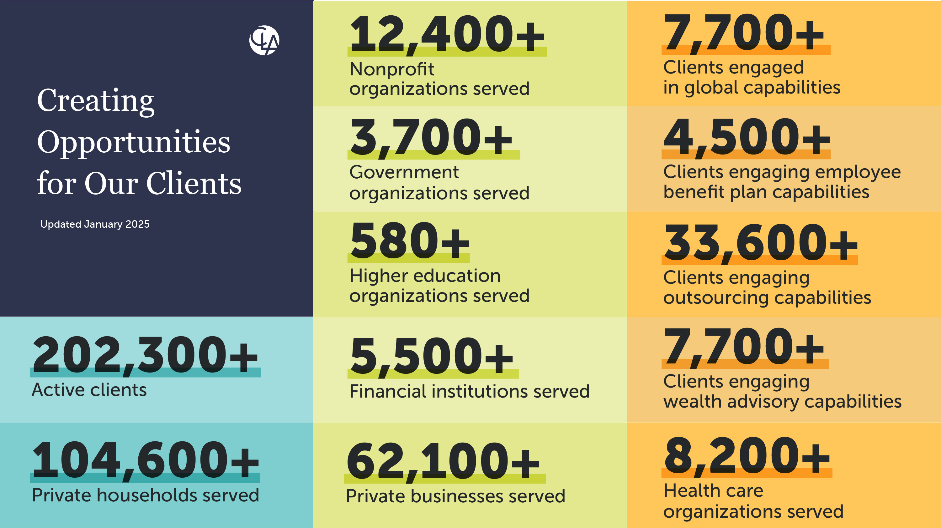
©2025 CliftonLarsonAllen LLP
Notes:
Every day our clients create new jobs, new wealth, and new opportunities. CLA places our clients at the core of our strategic focus because enabling their success means a better world for all of us.

Slide 17
Inspired Careers

Slide 18
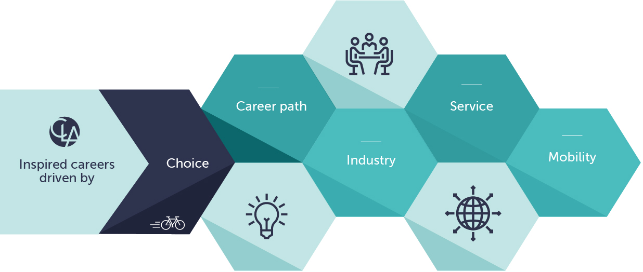
Our Inspired Careers Message is Simple
Your career … your journey

Slide 19
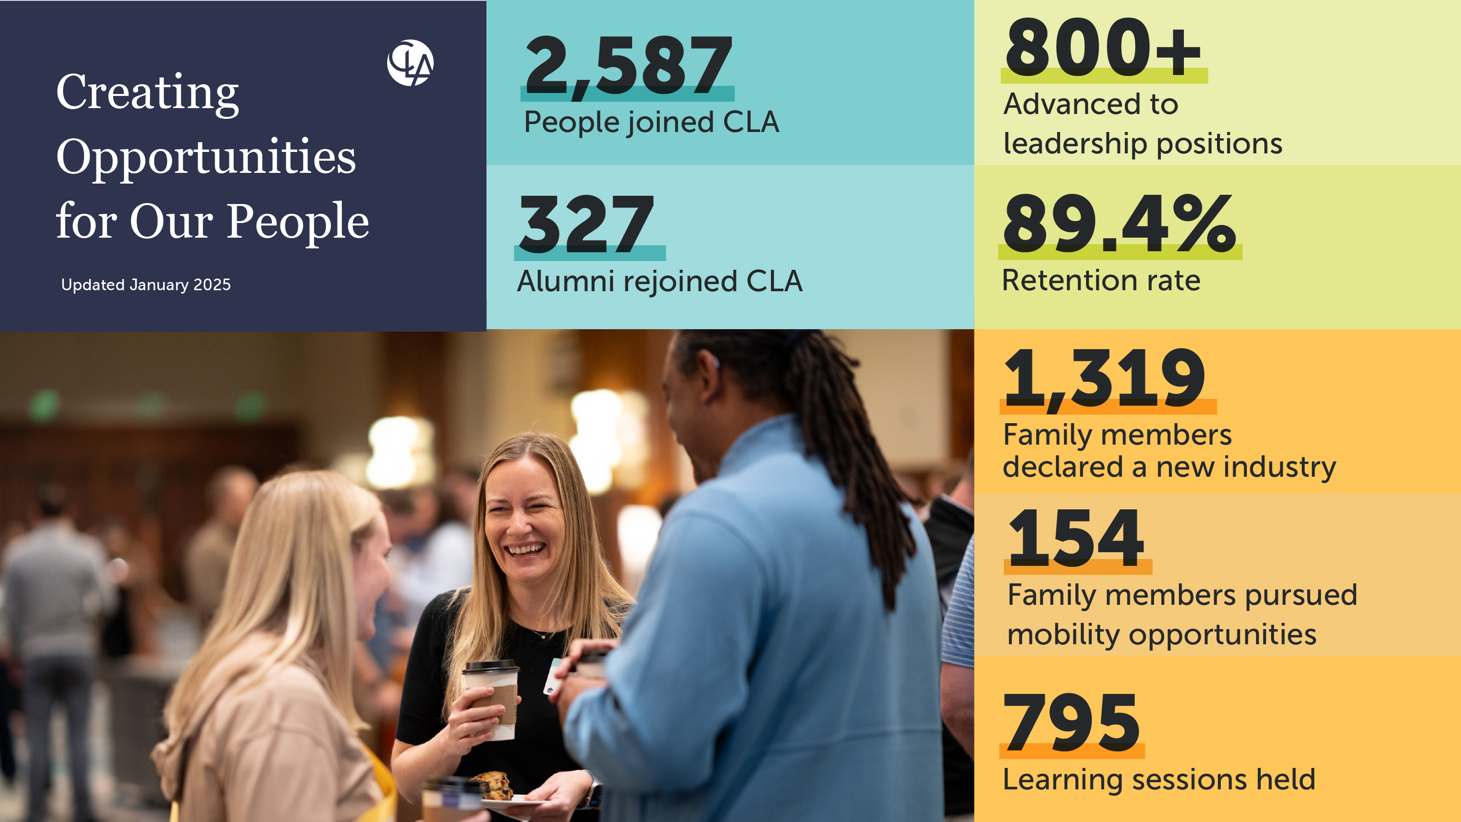
©2025 CliftonLarsonAllen LLP

Slide 20
Traditional Career Path
Partner
Sr. Manager
Manager
Sr. Associate
Associate

Slide 21
Overview of Career Paths
Alumni
Client Serving
Existing Client Growth, Seamless, Serve Clients
Associate
Senior
Director
Signing Director
External Facing, Capture Market Potential, Serve Clients
Manager
Principal
Heart of the House
Leads Heart of the House
Local Coordinator
Sr, Regional or FW Role
Director
Managing Director
Building Your Marketplace Value
Notes:
An inspired career is distinctly personal, made up of a unique blend of experiences, strengths, and choices. And because no two people are the same, every inspired career looks different.
The career coaching process at CLA helps people build on their strengths and provides access to meaningful experiences. Through these experiences, our people are empowered to make choices about their career path, industry alignment, service capability, and mobility — and ultimately live their inspired career.
Managing Director – EBS Path
Signing Director – Client Serving – Grow Existing clients
Principal – Client Serving – Market Facing, Growth through New Clients

Slide 22
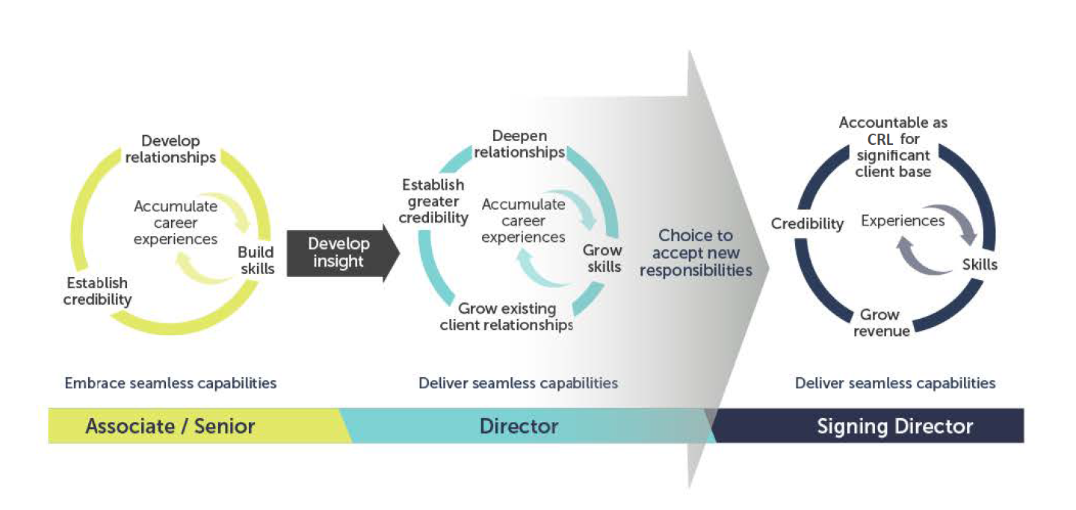
Inspired Careers: Director Path

Slide 23
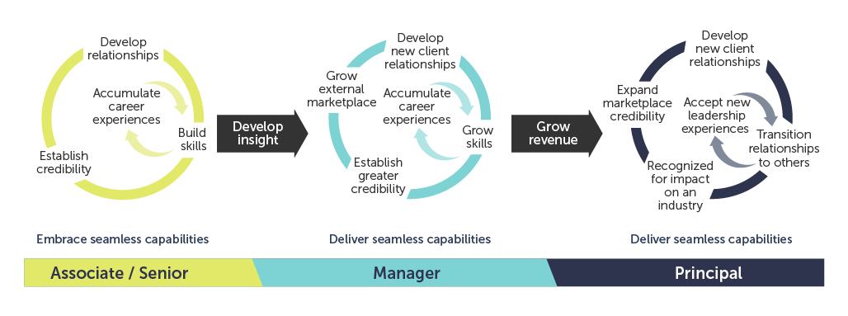
Inspired Careers: Principal Path

Slide 24

Individual Expectations
Client service
Personal development and CPE
Community service
Coaching and leadership
PTO, holiday, wellness
Business development
Inspired Career
INSPIRED CAREER JOURNEY

Slide 25


CLA is Certified as a Great Place to Work
CELEBRATE
83%
57%
83% of family members say CLA is a great place to work, compared to 57% of employees at a typical U.S.-based company.*
*Source: Great Place to Work®
Notes:
When you choose CLA, you deserve all of CLA. And using your voice in our family engagement survey will help us create a strong work culture that attracts and retains our people. One of the ways we capture your voice, we engage in surveys managed by Great Places to Work, a global authority on workplace culture. At CLA, we want you to come to work and leave feeling balanced, appreciated, and celebrated.
A Great Place to Work® certification demonstrates to the market that we are an employer of choice while also helping us build our culture using reporting, analysis, and action plans driven by the voices of our CLA family.

