Slide 1
Welcome!
Minnesota Government Training Academy 2024

Slide 3
Schedule
8:10 – 9 a.m. — GASB Update (all GASBs)
9:00 – 9:50 a.m. — Fraud Update
9:50 – 10:05 a.m. — Break
10:05 – 10:55 a.m. — Inflation Reduction Act
10:55 – 11:45 a.m. — Automation in Local Governments
11:45 a.m. – 12:30 p.m.— Lunch
12:30 – 1:20 p.m. — Pensions - Update on PERA
1:20 – 2:10 p.m. — Economic Update
2:10 – 3:00 p.m. — Social Engineering

Slide 4
GASB Update

Slide 5
At The End Of This Session, You Will Be Able To:
Learning Objectives
Identify how to apply accounting standards that are effective in the coming years.
Identify how to begin to prepare for GASBs 99, 100, 101, and 102
Recognize the status of current GASB projects

Slide 6
Where We’ve Been:
Statement Number | Name | Effective for periods ending:
GASB Statement No. 94 | Public-Private and Public-Public Partnerships and Availability Payment Arrangements | 6/30/2023 12/31/2023
GASB Statement No. 95 | Postponement of Effective Dates | Effective May 2020
GASB Statement No. 96 | SBITA – Subscription-Based Information Technology Arrangements | 6/30/2023 12/31/2023
GASB Statement No. 97 | Component Unit Criteria, Accounting for Section 457 Plans | 6/30/2022 (for the most part)
GASB Statement No. 98 | Annual Comprehensive Financial Report | 12/31/2021 6/30/2022

Slide 7
GASBs No. 94 PPP and APA GASBs No. 96 SBITAs
What We’ve Learned

Slide 8
GASB 94: Public-Private And Public-Public Partnerships And Availability Payment Arrangements
Arrangement in which a government (the transferor) contracts with an operator to provide public services by conveying control of the right to operate or use a nonfinancial asset, such as infrastructure or other capital assets for a period of time in an exchange or an exchange-like transaction
Nonfinancial
Asset
Public Services
Government
Operator

Slide 9
Things To Lookout For
Identify assets you own that are used to provide public service.
Who is operating the asset?
Do we pay someone, or do they pay us to operate the asset?
Does someone pay us to operate an asset they own?
Typical Examples:
Toll-collecting functions on Government’s roadways
Landfill/Waste Collection Facilities
Bus or Railroad Transportation Systems
Hospitals
Sports or Recreational Facilities

Slide 10
GASB 96: Subscription-Based Information Technology Arrangements
Subscription-Based Information Technology Arrangements (SBITA) – defined as a contract that conveys control of the right to use another party’s IT software as specified in the contract for a specified period of time in an exchange or exchange-like transaction
Standard is similar to GASB 87 - Leases

Slide 11
Things We’ve Seen And What To Lookout For
Software with an overarching contract are typically SBITA’s
Contracts with vendors for support services where the vendor holds the contract for the software being used
Auto-renewal considerations
More numerous than GASB 87: Leases but fewer apply to the standard due to term length

Slide 12
GASB 99 Omnibus

Slide 13
Effective Dates
The requirements related to LIBOR, accounting for SNAP distributions, disclosures of nonmonetary transactions, pledges of future revenues by pledging governments, terminology updates are effective upon issuance (April 2022)
The requirements related to leases, PPPs, and SBITAs are effective for fiscal years beginning after June 15, 2022
The requirements related to financial guarantees and derivative instruments are effective for fiscal years beginning after June 15, 2023

Slide 14
GASB 99 Highlights
Exchange/Exchange-like financial guarantees
If actual amount paid does not equal cumulative amount disclosed, disclose dates over which cumulative amount was determined.
Derivative Instruments that are neither investment derivative instruments nor hedges (“Other”)
Changes in FV go through income, classify separately from investment derivative income
Disclosure distinguish between other, investment, and hedging derivatives
Notes:
An exchange or exchange-like financial guarantee is a guarantee of an obligation of a legally separate entity or individual, including a blended or discretely presented component unit, that requires the guarantor to indemnify a third-party obligation holder under specified conditions.
2 paragraphs on hedge accounting

Slide 15
GASB 99 Highlights
Accounting for SNAP distribution
Terminology in GASB No 24 is no longer relevant
Follow provisions of GASB 33
LIBOR
No longer an appropriate benchmark interest rate for a derivative instrument
Notes:
Government Mandated- or voluntary nonexchange transactions

Slide 16
GASB 99 Highlights
Leases
Option to purchase that does not transfer ownership, exclude periods after date at which the option is reasonably certain to be exercised.
Leases
Variable payments that depend on an index or rate or those that are fixed in substance should be included in measurement of liability or receivable.
Variable payments based on future performance or usage should not be included.
Notes:
Short term – Maximum possible term of 12 months or less including options to extend

Slide 17
Leases, SBITAs, PPP Term
Do not remeasure liability/receivable solely for changes in index or rate
Provisions that allow for termination due to a violation of lease/SBITA, PPP terms, such as default on payments is not considered an option to terminate the lease/SBITA or PPP
Leases and SBITA – Short Term
Short term leases< 12 months
If modified:
Determined the modified term from the inception of the lease.
Lease term should be assessed beginning at modification date for purposes of measuring the receivable/liability.

Slide 18
GASB 100 Accounting Changes And Error Corrections – An Amendment Of GASB Statement No. 62
Effective date is fiscal years beginning after June 15, 2023 (6/30/24 & 12/31/24)

Slide 19
GASB State No. 62 Categories
Prior-Period Adjustments
Change in Accounting Principle
Change in Accounting Estimate
Change in the Reporting Entity
Correction of an Error

Slide 20
GASB State No. 100 Categories
Prior-Period Adjustments
Change in Accounting Principle
Change in Accounting Estimate
Changes to or within the Financial Reporting Entity
Correction of an Error

Slide 21
Change In Accounting Principles
Change from one generally accepted accounting principle to another
Only when new accounting principle is preferable considering qualitative characteristics of understandability, reliability, relevance, timeliness or comparability
Implementation of new accounting pronouncement
Think GASB 84, 87, and 96
Reported retroactively by restating beginning fund balance or net position as needed
Additional note disclosures are applicable
Most common one you will encounter (hopefully)
Notes:
Discuss Comparative slides too.

Slide 22
Not A Change In Accounting Principle
Events that are clearly different in substance
Occurring for the first time
Previously insignificant

Slide 23
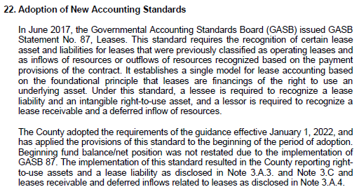
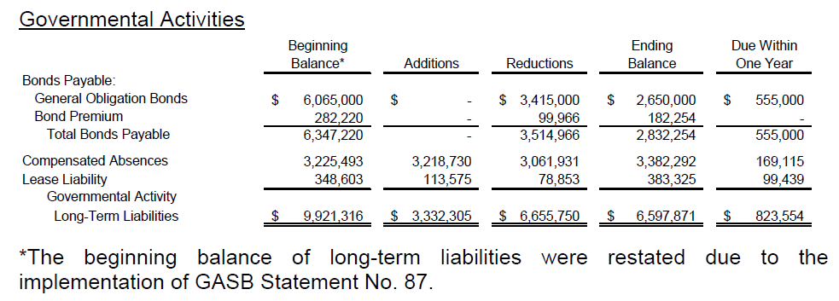
Change In Accounting Principles (Continued)
Additional Note Disclosures Required – Update to Note 1: Summary of Significant Accounting Policies
Restatement of Note Disclosure beginning balances

Slide 24
Change In Accounting Estimate
Estimates are amounts subject to measurement uncertainty
Should be justified on basis that newly adopted measurement methodology is preferable to the previous methodology used, except when the change is required by a GASB new pronouncement
Basis for determination – understandability, reliability, relevance, timeliness, consistency and comparability
Reported prospectively by recognizing the change in accounting estimate in the reporting period in which change occurs
Additional note disclosures are applicable

Slide 25
Notes For Change In Accounting Estimate
Nature of the change in accounting estimate – including financial statement line items affected
Change in measurement methodology
Reason for change
Explanation of why new measurement methodology is preferable – Exception if required by GASB pronouncement

Slide 26
Change In Accounting Estimate (Continued)
GASB added some clarification between an actual change in accounting estimate and an error correction:
Were there facts about conditions that existed as of the financial statement date that should have been taken into account when developing the estimate?
Could it be reasonable expected the government should have known about the facts at the time the estimates were prepare?
If you answer yes to both of those questions, the most likely result is this was an error correction.

Slide 27
Potential Change in Accounting Estimate Examples
OPEB Liability
Net Pension Liability
Landfill Post-Closure Liability
If measurement methods for any of these were changed due to a new preferable method, the results would be adjusted through the current year.
Notes:
GASB 62 – prior period adjustments, change in accounting principle, change in accounting estimate, change in reporting entity and correction of an error. GASB removed prior period adjustment as duplicative of other categories. Expanded definition of change in reporting entity

Slide 28
Changes To Or Within The Financial Reporting Entity
Addition or removal of a fund that results from the movement of continuing operations within the primary government
A change in a fund’s presentation as major or non-major
Addition or removal of a component unit
Change of presentation of component unit as blended or discretely presented
Beginning net position/fund balance should be adjusted for the effect of the change at the beginning of the reporting period
Additional note disclosures are applicable
NOTE: Excludes acquisitions, mergers, or transfers of operations, and component units reported pursuant to GASB 90, Majority Equity Interests

Slide 29
Change Within The Entity Example:
Solid Waste Fund moved OUT of General Fund:
Solid Waste Fund moved INTO the Non-Major Funds:

Slide 30
Correction Of An Error
Mathematical mistake
Mistake in application of accounting principle
Oversight or misuse of facts that existed at time of financial statements were issued
Facts that could reasonably be expected to have been obtained and taken into account about conditions that existed as of the financial statement date
Reported retroactively by restating beginning fund balance/net position
Additional note disclosures are applicable
Notes:
Also mention changes caused by applying principals from going to not GAAP to GAAP like straight line amortization to effective interest method, or going from not recording GASB 68/75 due to it being immaterial to having to record it because it’s material.

Slide 31
Correction Of An Error Example:
Krysta in AP is new and missed a large payable in the previous year:
Note that while the $100,000 might not be material to Governmental Activities, management can decide to adjust it as well to avoid reconciliation differences

Slide 32
Notes For Error Correction
Effects on beginning net position, fund balance, or fund net position
Nature of error and correction, including f/s line items impacted
Single period – effect on the prior period’s change in net position, fund balance or net position, as if the error didn’t happen
Comparative – effect of the error correction on the prior-period change in net position, fund balance or fund net position

Slide 33
GASB 101 Compensated Absences
Effective date is fiscal years beginning after December 15, 2023 (12/31/24 and 06/30/25)

Slide 34
The Basics
Replaces GASB Statement No. 16
Create a more consistent model that can be applied to all types of compensated absence arrangements
Attempts to address inconsistencies arising from types of leave not originally contemplates by GASB Statement No. 16.

Slide 35
What Are Compensated Absences?
Leave for which employees may receive one or more of the following:
Cash payments when the leave is used for time off
Other cash payments, such as payment for unused leave upon termination of employment
Noncash settlements, such as conversion to defined benefit post-employment benefits
Notes:
Termination of employment – refers to the end of an employee’s active service (voluntary or involuntary)

Slide 36
What’s Changing
GASBS 101
Consistent model applied to all leave types (limited exceptions)
“More likely than not” (MLTN) threshold for recognition
Removes certain disclosure requirements
Gross additions and deductions to the liability
Fund used to liquidate
GASBS 16
Different rules for different leave types (for example, sick leave)
“Probable” threshold for recognition
Disclose gross additions/deductions
Disclose fund(s) used to liquidate

Slide 37
GASB 101: What’s Not In Scope?
Termination benefits (GASB 47)
MLTN to convert to DB plan
Unlimited Leave
Sabbatical, if performing other duties

Slide 38
Compensated Absences Recognition
Leave that has not been used
Leave that has been used but not paid or settled

Slide 39
Recognition – Leave Not Used
Leave is attributable to services already rendered
Leave accumulates
Leave is more likely than not to be used for time off or otherwise paid or settled

Slide 40
What Is “More Likely Than Not”? (MLTN)
Defined in GASBS No. 101 as a likelihood of more than 50 percent
Generally viewed as a lower threshold for recognition than “probable” in GASBS No. 16

Slide 41
MLTN – What To Consider?
The government’s employment policies related to compensated absences
Whether leave that has been earned is, or will become, eligible for use or payment in the future
Historical information about the use, payment, or forfeiture of compensated absences
Information known to the government that would indicate that historical information may not be representative of future trends or patterns

Slide 42
Exceptions To MLTN
Leave that is dependent on the occurrence of an event that affects only a small proportion of employees
Recognize during the reporting period when leave has begun
Examples – Family Leave and Military Leave
Recognize unlimited leave and holiday leave that must be used on a specific date once it has been used

Slide 43
Exceptions - Example
Parental leave of three months is more likely than not to be paid, and a qualifying employee begins parental leave on June 1, a government with a June 30 fiscal year end would report a liability for the remaining two months of leave in financial statements dated June 30, because the leave had already begun
Government would include no liability for other employees who are entitled to and may take such leave in the future
Source: GASB 101. Literally. (gfoa.org)

Slide 44
Recognize If Not Used
Vacation
Sick
Holiday
Sabbatical, if unrestricted

Slide 45
Recognize When Leave Commences (Sporadic)
Military
Parental
Jury Duty

Slide 46
GASB 101: Recognize Only When Leave Is Taken
Holiday – if based on specific date and not at discretion of employee
Unlimited Leave

Slide 47
Calculating The Liability
Use the rate of pay in effect as of the balance sheet date when calculating the liability, with limited exceptions:
Arrangement calls for a different rate of pay at the time of payment (for example, sick pay being paid at 50% of the employee’s actual pay rate)
Shared leave pool - measure the liability using an estimated pay rate that is representative of the eligible employee population
If MLTN to be settled through noncash means other than conversion to DB plan

Slide 48
Recognition – Leave Used
Leave is used for time off but not yet paid in cash or settled through other means
Measure at the amount of the cash payment or noncash settlement to be made
Include applicable salary-related payments

Slide 49
Salary-Related Payments
Obligations that a government incurs related to providing leave in exchange for services rendered
May be directly associated or incrementally associated
Common example – Employer payroll taxes

Slide 50
DC And DB Pension Plans
Defined contributions (DC) plan
Leave that has not been used- liability is recognized whenever a compensated absence liability would be recognized and reported as pension or OPEB expense
Leave that has been used – include in pension/OPEB liability
Defined benefit (DB) plan
Payments related to a DB pension or OPEB plan should NOT be included in the measurement of the liabilities for compensated absences

Slide 51
Post-Employment Benefit Plans
Include in compensated absence liability if:
MLTN to be paid through distribution to individual account to be used for specified purposes (for example, payment of future premiums)
Leave has not been used
Otherwise meets criteria for recognition

Slide 52
Example: Vacation And Sick Leave
December 31, 2024 year end
Employment contract allows for the following:
Maximum accumulation of 300 vacation hours
300 sick hours not paid upon termination
DC pension with 10% employer contribution
Paid holiday on 1/1/2025
Government estimates 50% of sick leave MLTN to be used as paid leave.

Slide 53
Example: Vacation And Sick Leave
Employee has the following:
325 vacation hours
20 sick hours
$20/hour pay rate

Slide 54
Example: Vacation And Sick Leave Calculation

Slide 55
Example: Vacation And Sick Leave Explanations
Sick leave is accrued at 50% as the government has estimated it is MLTN that 50% will be used as paid leave
Holiday leave is not accrued because it is date specific and not at the discretion of employees
FICA Accrual – Directly associated with payment
DC pension – Report as part of comp abs liability for leave not used

Slide 56
Note Disclosure:
Disclosure should present either:
Separate increases/decreases
Net increase or a net decrease
If presenting net, indicate it is a net amount.

Slide 57
Note Disclosure:
No longer required to disclose:
Which governmental funds typically have been used to liquidate other long-term liabilities (such as compensated absences) in prior years
Prior year example:

Slide 58
Preparing For The New Standard
Identify relevant documents
Employee handbooks and policies
Employment contracts
Collective Bargaining Agreements
Understand systems/IT Controls used to track leave
Identify documentation to support inputs, such as wage rates and hours earned
Check to determine maximums have not been exceeded

Slide 59
GASB 102 Certain Risk Disclosures
Effective date is fiscal years beginning after June 15, 2024 (6/30/25 & 12/31/25)

Slide 60
GASB 102: Certain Risk Disclosures
State and local governments face a variety of risks
Risks refer to conditions that give rise to the potential for loss or harm to a government
Requirements exist already for certain risk exposures governments face, but there are other prevalent risks not routinely disclosed because they aren’t explicitly required
Statement looks to expand on disclosures around risks of concentrations and constraints

Slide 61
GASB 102 Risk Type Definitions
Concentrations
Defined as a lack of diversity related to an aspect of a significant inflow of resources or outflow of resources
A significant vendor or customer that accounts for a large portion of the governments expenditures/revenues
Constraints
Defined as a limitation imposed on a government by an external party or by formal action of the government’s highest level of decision-making authority
A limitation placed on a government to prevent an acquisition of resources or control spending

Slide 62
Disclosure Is Required If:
A concentration or constraint is known to the government prior to issuance
The concentration or constraint makes the reporting unit vulnerable to the risk of a substantial impact
An event or events associated with the concentration or constraint that could cause a substantial impact has occurred, have begun to occur, or are more likely than not to begin to occur within 12 months of the date the financial statements are issued

Slide 63
Notes To Financial Statements
What the concentration or constraint is
Each event associated with the concentration or constraint that could cause a substantial impact
Actions taken by the government prior to issuance to mitigate the risk
Information required to be disclosed if all the requirements are met is as follows:

Slide 64
What Is Considered A ‘Substantial Impact’
Intended to convey the fact that a risk is more than only the existence of a concentration or constraint
For instance, the State of MN’s total debt limit placed on Counties
More stringent criterion than materiality was needed to focus on circumstances that make a government have a heightened possibility of loss or harm
In the end the Board believes that professional judgement of both the quantitative and qualitative factors be used in each circumstance

Slide 65
What Is Considered An ‘Event Or Events’
This term has not been defined specifically
Ultimately means an event that could cause a substantial impact on a government’s existing concentrations or constraints
Governments don’t need to go searching for potential events, but instead disclose information about events when they become aware of them

Slide 66
What Happens If A Government Takes Mitigating Action?
If a Government discovers an event that will cause a substantial impact to its concentrations or constraints and takes action:
The mitigating action should be disclosed in the notes if the event is not remediated by the financial statement issuance date
If the situation is resolved, and there is no longer a risk of substantial impact to the government, no note disclosure is required

Slide 67
Example: Concentration Of Financial Resource Provider
Pilot City’s Airport Fund—a major enterprise fund that accounts for the City’s airport operations—reports a liability for revenue debt outstanding. Charges for services, such as landing fees and terminal rentals paid by the airlines that use the airport, are a significant revenue of the Airport Fund. In the bond indenture for the Airport Fund’s revenue bonds, the charges for services are identified as the sole source of repayment for those bonds, which funded the construction of certain improvements to the airport. Model Airways—the airport’s largest airline customer—accounts for 75 percent of the Airport Fund’s revenue generated from charges for services.
During the City’s fiscal year ended June 30, 2023, Model Airways notified the City that due to falling demand from the airline’s customers, it will terminate its lease and discontinue service to the City’s airport by December 31, 2023. The City’s financial statements as of June 30, 2023, were issued on October 15, 2023. The City is in the process of developing plans to attract new airline customers to the airport.

Slide 68
Example: Concentration Of Financial Resource Provider (Continued)
Assessment of disclosure criteria: In addition to assessing the disclosure criteria for the primary government reporting unit, the City assessed the disclosure criteria for the Airport Fund because it reports a liability for revenue debt.
Concentration: 75 percent of the Airport Fund’s charges for services are associated with a single airline customer. Charges for services are a significant revenue of the Airport Fund.
Vulnerability to the risk of a substantial impact: Management of the City has determined that the concentration of resources provided by a single airline (Model Airways) makes the Airport Fund vulnerable to the risk of a substantial impact.
Occurrence of an event or events and their timing: An event associated with the concentration occurred when Model Airways notified the City that it will not renew its lease. That event is the beginning of the airline’s discontinuation of services to the Airport, which the management of the City has determined could cause a substantial impact to the Airport Fund.
Mitigant: The City is planning to implement certain measures to attract new airline customers to mitigate potential losses from a discontinuation of services related to Model Airways. Because those mitigating actions had not occurred prior to the issuance of the financial statements, a description is not included in the disclosure.

Slide 69
Example: Concentration Of Financial Resource Provider (Continued)
Example Note Disclosure:
Note 9. Concentration of Financial Resource Provider
The Airport Fund accounts for the City’s airport operations and reports $10 million of revenue bonds outstanding on June 30, 2023. The bond indentures state that the revenue generated by airport operations is pledged as the sole source of repayment for the bonds. 75 percent of the Airport Fund’s revenues are associated with a single airline customer who has notified the City that it plans to terminate its lease and discontinue service to the City’s airport by December 31, 2023. A loss of revenue from that airline could adversely affect the Airport Fund.

Slide 70
What’s On The Horizon? Current GASB Projects And Practice Issues

Slide 71
Comprehensive Projects
Financial Reporting Framework
Final statement targeted for April 2024
Revenue and Expense Recognition
Final statement targeted for June 2027

Slide 72
Major Projects
Going Concern Uncertainties and Severe Financial Stress
Final statement targeted for June 2027
Infrastructure Assets
Final statement targeted for February 2027

Slide 73
Practice Issues
Classification of Nonfinancial Assets
Final Statement targeted for June 2024
Subsequent Events
Final Statement targeted or December 2025

Slide 74
Miranda Wendlandt, CPA, CFE Principal Miranda.Wendlant@CLAconnect.com Eric Smedsrud, CPA Senior Eric.Smedsrud@CLAconnect.com 320-203-55344
Notes:
Party (Shots)

Slide 75
Ethical Challenges And Fraud Risks Facing Governments

Slide 76
Learning Objectives
At the end of this session, you will be able to:
Identify common ethical challenges facing government officials
Identify recent cases of fraud in state and local governments
Identify key concepts in fraud awareness and prevention
Describe key concepts in ethics
Discuss fraud and ethics within local governments

Slide 77
Speaker Introduction
Principal
Chris is a seasoned professional with over 20 years of experience in assurance and consulting for governmental and nonprofit entities. Throughout his career, he has worked with a diverse range of organizations, including local governments, state agencies, schools, and higher education institutions. His knowledge includes audit, internal controls evaluations, new standard implementations, and providing fraud and ethics training.
Chris Knopik,
CPA, CFE

Slide 78
Ethics In Business

Slide 79
Ethical Leaders Start At Home
Personal Ethics
Values
Moral choices
What we do when no one is looking
Can change over time, by situation, or role
Defined by:
Faith, spirituality
Upbringing, family
Laws, civil rights, academia
Business Ethics
Personal Ethics
Values of the employees
Organizational Culture
Tone at the top
History of the company
Perception of what is acceptable
Organizational Systems
Policies and rules in place
Regulatory oversight
Code of ethics and how it’s monitored and enforced
Notes:
Ethics, at their essence, are those values that you consider important to your life. The moral choices that guide how you live your life. It’s what you do when no one is looking.
Personal ethics are important to organizations because it all starts with the individual:
-You bring your personal ethics and values to work with you every day.
-Your personal ethics will always dictate what you do at work and how you handle situations, and in turn, that will drive the ethics of a business.
-The personal ethics of every single person who works at the organization will determine what the organization’s ethics look like.
In addition to the personal ethics of the individuals making up an organization, there are also two other factors that determine if a business is ethical:
-Organizational culture: – tone at the top (heavily influenced by the personal ethics of leadership), history (does the organization have a long-standing history of being ethical?), perception of what is acceptable and what is not.
-Organizational systems: – Policies, rules, regulatory oversight, monitoring tools such as fraud hotlines

Slide 80
Principles Of Ethics In Business
Honesty
Integrity
Loyalty
Fairness
Respect
Courage
Reliably share information with employees
Be consistent between words and actions
Recognize others for their accomplishments
Hold all employees accountable
Practice active listening
Welcome and encourage diverse viewpoints
Speak up when you see mistreatment
Speak up when you see unethical behavior
Tell the truth in communication and action
Treat others the way you want to be treated
Honor your commitments
Respect confidential information
Notes:
-Ethical principles are universal standards of right and wrong.
-They suggest the kind of behavior an ethical company or person should and should not engage in.
-These principles provide a guide to making decisions, and they also establish the criteria by which your decisions will be judged by others.
Talk about ones that are specific to the financial aspect of the company.
-Integrity – being consistent between words and actions (tone at the top, lead by example)
-Courage – speaking up when you see unethical behavior

Slide 81
Why Is Ethics Important In Business?
Helps employees make good decisions; leads to happier, more satisfied employees
Reduces liability
Ensures high quality customer service
Most importantly, keeps everyone off the front pages!
This Photo by Unknown Author is licensed under CC BY-ND

Slide 82
Breakdowns In Business Ethics
Moral Muteness
Not speaking up when witnessing unethical behavior
Unwillingness to discuss ethics
Discussing practices/decisions in a way that obscures your moral position and ethical beliefs (Bird & Walters, 1989)
Ethical Fading
Erosion of the ethical standard of a business in which employees become used to engaging in or condoning bad behavior
Situational Influence
Intent to please authority figure
Focused on achieving a goal
Notes:
Moral Muteness: When we see others acting unethically, often the easiest thing to do is look the other way. This goes back to COURAGE being such a critical factor in an ethical leader.
An employee may be fearful about speaking up because they don’t want to lose their job
Employees may feel pressure to “play along” in order to keep their job
Ethical Fading: Ethical Fading helps people minimize the guilt they feel from violating ethical standards.
The longer employees go without speaking up, or the more others see the bad behavior with no repercussions, the more impact on the culture of the organization.
Situational Influence: Evidence suggests that certain situations can persuade ethical individuals to act in opposition to their values.
Can you think of a situation where you were so intent upon pleasing an authority figure, fitting in with your friends, or achieving a goal that you failed to give an ethical issue your full attention? Did that situation cause you regret?

Slide 83
Examples Of Ethical Challenges Leading To Fraud
Declines in revenues/funding
Charging non-grant costs to federal/state contracts
Employee had an accidental mischarge on a credit card that was not caught
Trying to get the work done under a time crunch
Manager concerned about employee quitting due to compensation concerns
Abuses of credit cards – meals, travel, etc.
Not following procurement laws to award contract
Allowing employees to pad their timesheets to compensate for “value”

Slide 84
Fraud In State And Local Governments - Internal
Purchasing/ Disbursement
Payroll
Unauthorized pay increases or stipends
Fictitious vendor
Misdirected funds
Failure to report PTO
Excessive overtime
Cash Receipts
Theft of incoming cash
Fraudulent refunds
Grants/ Benefits
Falsifying documentation to obtain funds
Falsifying documentation to give funds
Contracts
Bid splitting
Conflicts of interest
Personal use of credit cards
Ghost employee
Misclassifying payments
Improper use of funds
Kickbacks
False expense claims

Slide 85
Fraud In State And Local Governments - External
Identify Fraud
Phishing
Suppliers/ Vendors
Contractors
Outsider posing as known customer/vendor
Could be a “new person” at the vendor
Overcharging
Obtain account access
Pose as internal employee
Holding systems for ransom
Under delivering
False overtime
Fraudulent change orders
Conflict of interest (project manager)

Slide 86
The Trajectory Of Fraud
Starts out small
Increases in complexity and aggressiveness
Grows in magnitude and number of participants

Slide 87
Fraud Risks In Local Governments

Slide 88
Vulnerabilities And How To Address Them
Inadequate Segregation of Duties
Lack of Oversight and Monitoring
Poor Record-Keeping Practices
Assess roles and identify anyone with too much control
Implement regular monitoring procedures
Safeguard physical assets such as cash and checks (locked drawer, safe, etc.)
Consider compensating controls like review/oversight
Maintain documents that support financial transactions in a secure location (physical or electronic)
Ensure documents are organized and easily accessible
Adjust level of access to those that need it
Example reports to review: monthly reconciliations, bank and credit card transactions, vendor change report, payroll change report, etc.
Inadequate Security Controls
Safeguard electronic assets (require strong passwords, changing passwords, restricting access, etc.)

Slide 89
Vulnerabilities And How To Address Them
Insufficient Training and Communication
Lack of Policies and Procedures
Document processes and procedures in writing
Provide training to employees on their roles
Ensure consistent and transparent policies
Stress importance of internal controls
Promote open communication with management
Document proper authorization and approval processes
Not Reconciling Systems To Each Other
Reconcile subsidiary ledgers to the general ledger regularly
Consider automation options between systems
Ensure review of manual entries to record activity from an external system
Implement fraud or ethics policy or include in code of conduct (consider hotline or other anonymous reporting method)

Slide 90
Who Presents Risk To The Government?
EVERYONE

Slide 91
Who Presents The GREATEST Risk?
High Authority
Long Tenure
Little Oversight
Notes:
Generally, those in higher authority and those with a long tenure at the organization commit fraud at higher magnitudes. If there is little oversight as well, the potential fraud risk is significant.

Slide 92
Behavioral Red Flags

Slide 93
Behavioral Red Flags In Occupational Fraud
Source: ACFE 2022 Report to the Nations
Notes:
These are the results of a bi-annual survey conducted by the Association of Certified Fraud Examiners related to Occupational Fraud, or the fraud committed by people within an organization. You’ll notice that the most frequent red flag is living beyond means and that 85% of all fraudsters related to this survey displayed at least one red flag. However, this is not a given, as some fraudsters don’t display any of these red flags.

Slide 94
Lifestyle Changes
Most people who commit fraud do so under financial pressure
Once perpetrators meet their financial needs that initially motivated them, they usually continue to steal and use the money to enhance their lifestyle
New cars
Expensive homes
Lavish vacations

Slide 95
Unusual Behaviors
When people commit crimes (especially first time offenders, as many perpetrators are), they are engulfed by feelings of fear and guilt. These emotions express themselves in unusual behavior.
No particular behavior signals fraud; rather, changes in behavior are signals.
Examples include refusal to take vacation and not willing to delegate work or relinquish control.

Slide 96
Accounting Anomalies
Accounting records are often manipulated to conceal fraud, so anomalies and problems with accounting documents are common red flags of fraud
Missing documents
Excessive voids or credits
Common names or addresses of payees or customers
Alterations on documents
Revisions to vendor files (address, payee name, bank info)
Certain records may also be unusual or unrealistic
Excessive purchases
Multiple payments to the same vendor in a month
Unreasonable expenses or reimbursements
Significant increases or decreases in account balances

Slide 97
Examples Of Red Flags From Recent Cases
Cash Skimming
Financial difficulties
Control issues
Personal Use of Credit Card
Living beyond means
Financial difficulties
Defensiveness
Refusal to take vacations
Control issues
Bullying
Wheeler-dealer attitude
Complained about pay
Conflicts of Interest
Unusually close with vendors
Control issues
Excessive pressure from organization and stakeholders
Notes:
Cash skimming is the recycling center case, person took cash that was collected at the scale house and never included it in the deposit slip or GL recording.
Personal use of credit card is the manufacturing company case where the former CEO used a variety of methods to take advantage of company funds, including using his company credit card to fund his excessive personal travel.
Conflicts of interest is the state agency where the former Executive Director directed grant funding to friends and family under the guise of providing services to low income families, among other schemes.

Slide 98
Recent Cases Of Fraud In State & Local Governments
Case Study #1

Slide 99
Tribal Housing Department
Allegations that Covid Relief funds were being mismanaged
Allegation that funds were used to renovate homes for relatives and friends of housing employees rather than qualified tribal members
Allegations of exorbitant renovations
Allegations of collusion with and kickbacks from contractors

Slide 100
Factors Leading To Fraud
No review by others
Management delegating authority
Willful Blindness
Sole responsibility for approval of contracts
Management/council overrides of procedures
Lack of accountability

Slide 101
Recent Cases Of Fraud In State & Local Governments
Case Study #2

Slide 102
Overview – Transportation Coalition Service Contractor
Contractor operated demand response transportation for the City as well as for urbanized areas
Received payment for this contract by way of reimbursement requests submitted to the City and through the State Department of Transportation as a sub-recipient
The City owned the busses, and the contractor employed drivers and administrators to administer the bus route services
Contractor was submitting reimbursement requests for the same expenses to both the City and the State resulting in $285,000 in duplicate reimbursements paid to the contractor
Notes:
Limited scope October 2018 through April 2021.

Slide 103
Factors Leading To Fraud
Limited review by others
30+ year history
Lots of trust and respect
Supporting documentation was not provided to the State
Systems not linked
Contractor had an inadequate accounting system
Notes:
Contractor has a longstanding history with the State dating back to 1982
This problem surfaced because of changes in reimbursement processes where the vendor began receiving funds through the CARES Act while also receiving funds directly from local governments.

Slide 104
Discovery Of Discrepancies
Discovered because of a Single Audit performed by the FTA
Forensic audit conducted by the City identified certain expenses that were duplicated
Prompted a more complete investigation of all reimbursement requests and payments

Slide 105
Forensic Investigation
Interview of staff at the City and the State transportation departments
Analysis of financial records, reimbursement requests and support provided for reimbursement
Identification of expenses submitted to both entities for reimbursement
Interview of subject
Report of findings, including recommendations

Slide 106
Interview Of Subject
Inquired regarding role and responsibilities
Identified individuals responsible for submitting reimbursement requests
Gained an understanding of processes and procedures for expense tracking, monthly billing process, and systems utilized
Asked about duplicate expenses identified
Notes:
The interviews were conducted to document and gain an understanding of processes and procedures for expense tracking, monthly billing process, systems utilized, and
roles and responsibilities, and individuals responsible for submitting and approving grand funding requests.

Slide 107
Conclusions
Identified over $285,000 in duplicated expenses
New procedures were implemented
Reimbursement requests made for the same expenses to both the City and State
Total expenses requested and reimbursed from both jurisdictions exceeded the total expenses in contractor’s P&L for 12 of the 16 months
Require supporting documentation for all expenses
Communication between jurisdictions prior to reimbursement of expenses
Verification that vendors have adequate accounting systems in place to support any and all expenses associated with the project

Slide 108
Key Concepts In Fraud Awareness & Prevention

Slide 109
Recommendations To Mitigate Fraud Risk
At least two people are looking at every transaction (adequate segregation of duties)
Ensure secondary approval by someone with knowledge of the business area
Trust is NOT an internal control – ensure proper and sufficient supporting documentation for all transactions
Ensure regular and timely reconciliation of asset accounts; ensure the reconciliations are reviewed
Notes:
There are a myriad of fraud schemes and what can go wrong within an organization. And it would be impossible to discuss all possibilities. To know where your organization is most susceptible to fraud, you have to conduct a fraud risk assessment. This will help your organization assess the level of fraud risk in difference business processes/areas.
But when you take into consideration the various business processes and types of transactions your organization handles, we’ve compiled a list of things you should be doing in every business area and every transaction type to help mitigate the risks of fraud.
Every transaction in your organization should be touched or looked at by at least 2 people. This generally exists as a request and approval. You’d be surprised how many investigations we conduct where an employee is given complete autonomy and there isn’t anyone else looking over their transactions or there is an insufficient approval hierarchy.
Which leads me to the second bullet. Ensure that there is a secondary approval by someone with knowledge of the business area. Many of our city and county clients are fairly desegregated, and departments have their own accounting function/staff. Disbursements to vendors are initiated by the department and “approved” by finance/accounting for payment. Typically, finance/accounting is looking at whether there is supporting documentation and verifying that the invoice/payment request complies with any contract terms (if applicable). Finance would not know if the vendor is a legitimate vendor that the organization is doing business with or if there is anything suspicious about the payment request. And we’ve conducted several investigations where the accounting person in a particular department is the only approval required for certain disbursements. Now other factors and weaknesses would have to exist, but this can be exploited using falsified invoices that are paid and no one else in the department was required to review or approve those invoices. As long as finance has supporting documentation and an active vendor in the system, a payment will be made.

Slide 110
Recommendations To Mitigate Fraud Risk
Conduct regular monitoring and management review
Mandatory job rotation and/or vacations
Implement the use of positive pay with your bank (if available, include payee/account name positive pay)
EFT/ACH/Wires – Third-party services that verify bank account information
Require confirmation when vendor change requests are received
Ensure adequate IT and system controls (multi-factor authentication, firewalls, etc.)
Notes:
Monitoring/management review – examples:
Vendor master change report
Payroll change report
Activity on a one-time vendor or temporary vendor account
Refund activity
Cash collections and deposits
Financial reports (budget to actual; trend analysis)
Surprise audits
Mandatory job rotation and/or vacations ensure that business-critical skills are not limited to a single person. In an unexpected absence, there is already someone trained that can step in. An added benefit is that it is much harder for a fraudster to cover their tracks when someone else steps into their position either through rotation or when they are on vacation. This process can also help find errors. Require 5-10 days of consecutive vacation, and ensure someone else is assigned their work while on vacation.

Slide 111
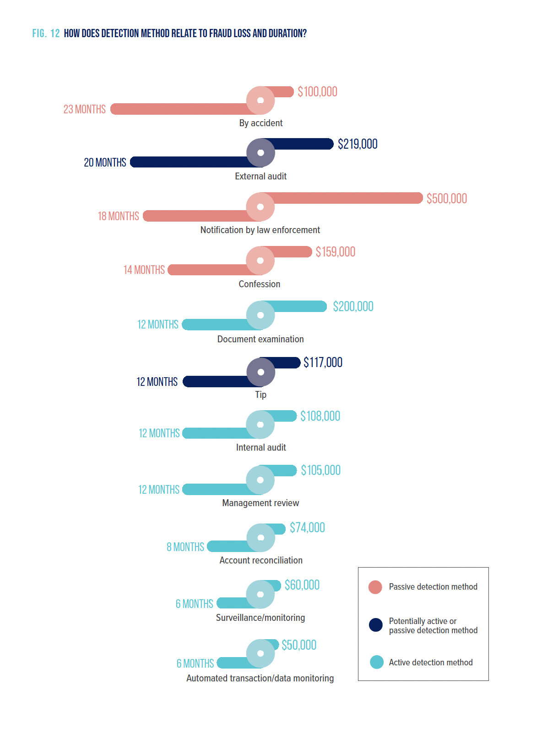
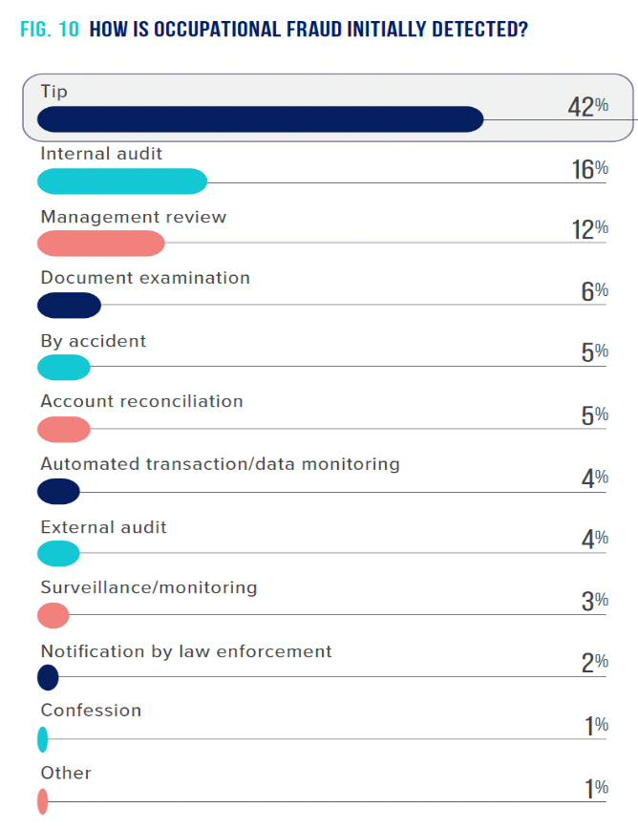
Median Loss & Duration by Detection Method
Source: ACFE 2022 Report to the Nations
Notes:
These graphs depict how fraud is initially detected and the median loss and median duration based on the method of detection of the fraud scheme.
The data shows that some fraud detection methods are more effective than others in the sense that they correlate with lower fraud losses (they are discovered sooner). This illustrates the importance of the controls shown in light blue to reduce the duration and dollar loss from fraud. What we can learn from this data is that when fraud is detected proactively, it tends to be detected more quickly and thus causes lower losses. Passive detection results in lengthier schemes and increased financial harm to the victim organization.

Slide 112
Limitations For Mitigating Fraud Risk
No set of internal controls guarantee prevention of fraud
What is your fraud risk tolerance?
Lower tolerance = more controls
Critical component to detecting fraud – monitoring and management review
Vendor master change report
One-time/temporary vendor number
Manual check request or refunds
Payroll change report
Monthly reconciliations
Notes:
With collusion, it’s even harder to prevent fraud.
To help avoid significant negative impact on the efficiency and effectiveness of operations, carefully balance and think through the internal controls and anti-fraud measures implemented by your organization. Management and those charged with governance should establish a fraud risk tolerance level, meaning how much fraud risk the organization is willing to assume to meet the desired efficiency level for operations. The lower the organization’s fraud risk tolerance, the more processes and procedures must be put in place to help prevent and detect fraud.

Slide 113
Attributes Of An Anti-Fraud Program
Person or office responsible for anti-fraud, ethics, and compliance
Empowered by management and governance
Lead by example (“tone at the top”)
Management and governance promote an environment of integrity
Encourage transparency and accountability
Review, oversight, monitoring
Well-developed anti-fraud and ethics policy and/or code of conduct
In writing, communicated to and acknowledged by employees
Well-developed and updated written policies and procedures
Kept current and acknowledged by employees
Notes:
We spoke earlier about how culture plays such a significant role in the behavior of employees. What should your organization be doing to ensure a culture of high integrity and ethics?
Tone at the Top:
Tone at the top refers to the ethical atmosphere that is created in the workplace by the organization's leadership.
If the tone set by managers upholds ethics and integrity, employees will be more inclined to uphold those same values.
It takes more than a code of ethics.
A negative work environment will spawn low levels of employee morale. Employees will be more prone to committing fraud since there is no obligation to protect it.
Source: https://www.acfe.com/uploadedFiles/ACFE_Website/Content/documents/tone-at-the-top-research.pdf
Ethical leadership is not only the responsibility of leaders in the company. Yes, they are the most visible examples and may have the most impact, but each person has someone that is looking to you to be that ethical leader – in our families that is our kids…at work it may be the new employee who is just starting their career. To be an ethical leader you must be willing to do what is right even when it is unpopular, unprofitable, or inconvenient.

Slide 114
Attributes Of An Anti-Fraud Program (Continued)
Regular technical training of employees on policies, procedures, applicable laws, ethics, fraud awareness, etc.
Internal or external instructors
Strong compliance/internal audit programs
Internal, outsourced, or combination – prioritized by management and governance
Established fraud and ethics hotline
Anonymous, confidential, protect whistleblowers – prioritized by governance
Reinforce good behavior and don’t reinforce bad behavior
Follow through on reports of misconduct – encourages people to come forward
Notes:
This slide (final bullet point) is where we should mention the benefits of making a criminal referral and downfalls to not doing so, from a deterrent and tone at the top perspective.
Why employees don’t report unethical conduct:
No corrective action – Employees who were cynical of their organizations felt that nothing would be done if they came forward and reported the misconduct that they observed. In 2005, 59 percent of those who did not report misconduct felt as though no corrective action would be taken if they had reported unethical conduct. However, the NBES states that these employees may have had an unrealistic expectation for how organizations should handle misconduct reports. Privacy restrictions may prevent the company from telling the whistleblower how the report was handled and what punishments were assessed to the suspicious perpetrator. The company should stress the privacy factor in order to boost confidence in these employees that their reporting will be handled appropriately, even if the whistleblower may not find out about it.
• No confidentiality of reports – Another concern for those who do not report misconduct is the fear that if they were to come forward with a report, their identities, as well as their suspicions, would be revealed.
• Retaliation by superiors – Not surprisingly, this same group of employees also felt that if their identities were exposed, they would have to suffer retaliation from the superiors. The fear of retaliation caused them not to report misconduct.
• Retaliation by coworkers – Similar to retaliation by superiors, employees who withheld reporting unethical behavior in the workplace feared that their coworkers would find out who blew the whistle and retaliate against them.
• Unsure whom to contact – A small number of the employees who did not report misconduct (18 percent in 2005) said they were unclear whom to contact in order to raise their suspicious of unethical conduct.

Slide 115
Questions?

Slide 116
Christopher Knopik, CPA, CFE
Principal | State and Local Government
Christopher.Knopik@CLAconnect.com
612-397-3266

Slide 117
15 Minute Break
9:50-10:05 a.m.

Slide 118
Monetizing Clean Energy Tax Credits From The Inflation Reduction Act

Slide 119
Agenda
During this session, we will discuss:
Specific Credit Opportunities
Bonus Credits
Credit Monetization
The Inflation Reduction Act

Slide 120
Learning Objectives
At the end of the session, you will be able to:
Discuss how the Inflation Reduction Act can impact local governments

Slide 121
The Inflation Reduction Act

Slide 122
IRA Snapshot
Creates and modifies a number of renewable energy credits as well as financing programs
Creates new monetization options for tax-exempt and taxable entities
Section 6417 provides an elective pay option (i.e., cash refund) for:
Tax-exempt organizations
State and local governments
Tribal governments
Rural electric cooperatives
Section 6418 provides a transferability option for for-profit organizations
Taxpayers can buy and sell credits for cash
IRS portal launched in Dec. 2023 → registration is live
Treasury and IRS have released some guidance, but more to come

Slide 123
Refundable/Transferable Credits
§30C Alternative fuel vehicle refueling property credit
§45 Electricity produced from certain renewable resources, etc.
§45Q Credit for carbon oxide sequestration
§45U Zero-emission nuclear power production credit
§45V Credit for production of clean hydrogen
§45W Credit for qualified commercial clean vehicles (elective pay only)
§45X Advanced manufacturing production credit
§45Y Clean electricity production credit
§45Z Clean fuel production credit
§48 Energy credit
§48C Advanced energy project credit
§48E Clean electricity investment credit

Slide 124
Opportunities For SLGs
New building construction and renovations
Fleet electrification and charging infrastructure
HVAC improvements
Solar panel installations
Pricing leverage for Section 179D allocations
Capital project forecasting

Slide 125
Specific Credit Opportunities

Slide 126
Section 48 Energy Investment Tax Credit
Tax credit for a percentage of the cost of placing specified energy property into service
Base credit rate is 6%
30% if less than 1 megawatt
Applies to:
Solar
Wind
Biogas
Geothermal
Energy storage property
Microgrid controllers
Electrochromic glass
Combined heat and power systems

Slide 127
Section 45 Production Credit
Per kWh credit for production of electricity from renewable sources
Prevailing wage and other bonus credits available
Applies to:
Solar
Wind
Geothermal
Biomass
Rates vary depending upon energy source
Municipal solid waste
Hydroelectric

Slide 128
Section 30C Alternative Fuel Refueling Credit
Credit Amount
6% of the cost of any single item of qualified property not meeting prevailing wage, up to $100,000
Basis and Recapture
Basis in property must be reduced by amount of the credit
Basis does not include any property expensed under Section 179
Recapture required if property ceases to be qualified property
30% of the cost of qualified property if prevailing wage is met, up to $100,000

Slide 129
Section 30C Cont’d
Qualified property
Property used for the storage or dispensing of alternative fuel into the fuel tank of a motor vehicle propelled by that fuel
Includes fuel tanks, pumps, and other property used to transfer fuel
Alternative Fuels
Electricity
At least 85% of its volume consists of one or more of the following:
Compressed natural gas
Liquified natural gas
Liquified petroleum gas
Natural gas
Hydrogen
Ethanol

Slide 130
Census Tract Requirements
Effective 1/1/23, qualified property must be installed in locations that meet the following census tract requirements:
The census tract is not an urban area
A population census tract where the poverty rate is at least 20%; or
Metropolitan and non-metropolitan area census tract where the median family income is does not exceed 80% of the state median family income level

Slide 131
Section 45W Clean Vehicle Credit
Applies to clean commercial vehicles and mobile machinery acquired or leased after 2022 and before 2033
Credit equals the lesser of:
- 15% of the vehicle’s basis (30% if fully electric) or
- Incremental cost of the vehicle
Max credit is:
- $7,500 for vehicles less than 14,000 GVWR, and
- $40,000 for all others

Slide 132
Bonus Credits

Slide 133
Prevailing Wage And Apprenticeship
Increases the base credit by 5X generally
A prevailing wage is a wage the federal government requires to be paid by contractors to workers under the Davis-Bacon Act
Hourly wage plus overtime and benefits as set by the Department of Labor based on the locality where the construction, alteration, or repair is being performed
Apprentices must work a certain percentage of the total labor hours depending on when construction of begins

Slide 134
Domestic Content Bonus
Projects are eligible for an additional bonus credit of 2% (10% if 5X multiplier applied) if the following conditions are met:
100% of any steel or iron that is a component of the facility is manufactured in the United States
Not less than 40% of the manufactured components of the facility are manufactured in the United States
100% of steel and iron produced from the US
At least 40% of manufactured components produced in US

Slide 135
Energy Communities
Projects are eligible for an additional bonus credit of 2% (10% if 5X multiplier applied) if the facility is located in any of the following:
A brownfield site
An area that:
Has (or, at any time during the period beginning after December 31, 2009, had) 0.17% or greater direct employment or 25% or greater local tax revenues related to the extraction, processing, transport, or storage of coal, oil, or natural gas, or
Has an unemployment rate above the national average for the previous year, or
Has a census tract or a census tract that is adjoining a census tract in which a coal mine has closed after 1999 or a coal-fired electric generating unit was retired after 2009

Slide 136
Low-Income Communities
Project is built in a low-income community as defined by the New Markets Tax Credit or on Indian Land can receive an increased tax credit of 10%
Project associated with a low-income residential building project, or a low-income economic benefit project, can receive an increased tax credit of 20%

Slide 137
Credit Rate Tables
www.epa.gov/green-power-markets/summary-inflation-reduction-act-provisions-related-renewable-energy

Slide 138
Credit Rate Tables Cont’d
www.epa.gov/green-power-markets/summary-inflation-reduction-act-provisions-related-renewable-energy

Slide 139
Credit Monetization

Slide 140
Claiming Direct Payments
Pre-filing registration
Must be completed prior to filing the tax return where a direct pay election is made
Must provide certain information about organization, the credits you intend to claim, and details regarding the property giving rise to the credit
A registration number will be issued that will be required when making the election on tax return
IRS will issue a separate registration number for each applicable credit property
Making the election on a tax return
Must be made on a timely filed return (including extensions) → cannot be made on an amended return
Form 3800 (General Business Credit)
Applicable credit form and registration info from above
IRS is advising a minimum of 120 days to process registrations
Must be filed on Form 990-T by due date along with:
State and local governments that do not file a tax return will need to file a Form 990-T for this limited purpose

Slide 141
Section 179D Deduction Allocations

Slide 142
Section 179D Energy Efficient Building Deduction
How it works
Per square foot deduction for the construction or renovation of energy efficient buildings
Opportunity for SLGs
Deduction can be allocated by SLGs to designers of building systems (often this will be the architect)
Sliding scale up to $5.00 per sq. ft. if prevailing wage/apprenticeship requirements are met
Based on ASHRAE energy efficiency standards
Buildings must be modeled and certified by third-party engineer
Allocation process is simple (standard letter template)
Could mean indirect benefit to through pricing negotiations
Plan for it during bid and proposal phase of projects

Slide 143
Thank you!
Michael De Prima
Principal
Michael.DePrima@CLAconnect.com
239-280-3548

Slide 144
Automation And AI: Use Cases And What’s In It For You
Revolutionizing Finance and Accounting

Slide 145
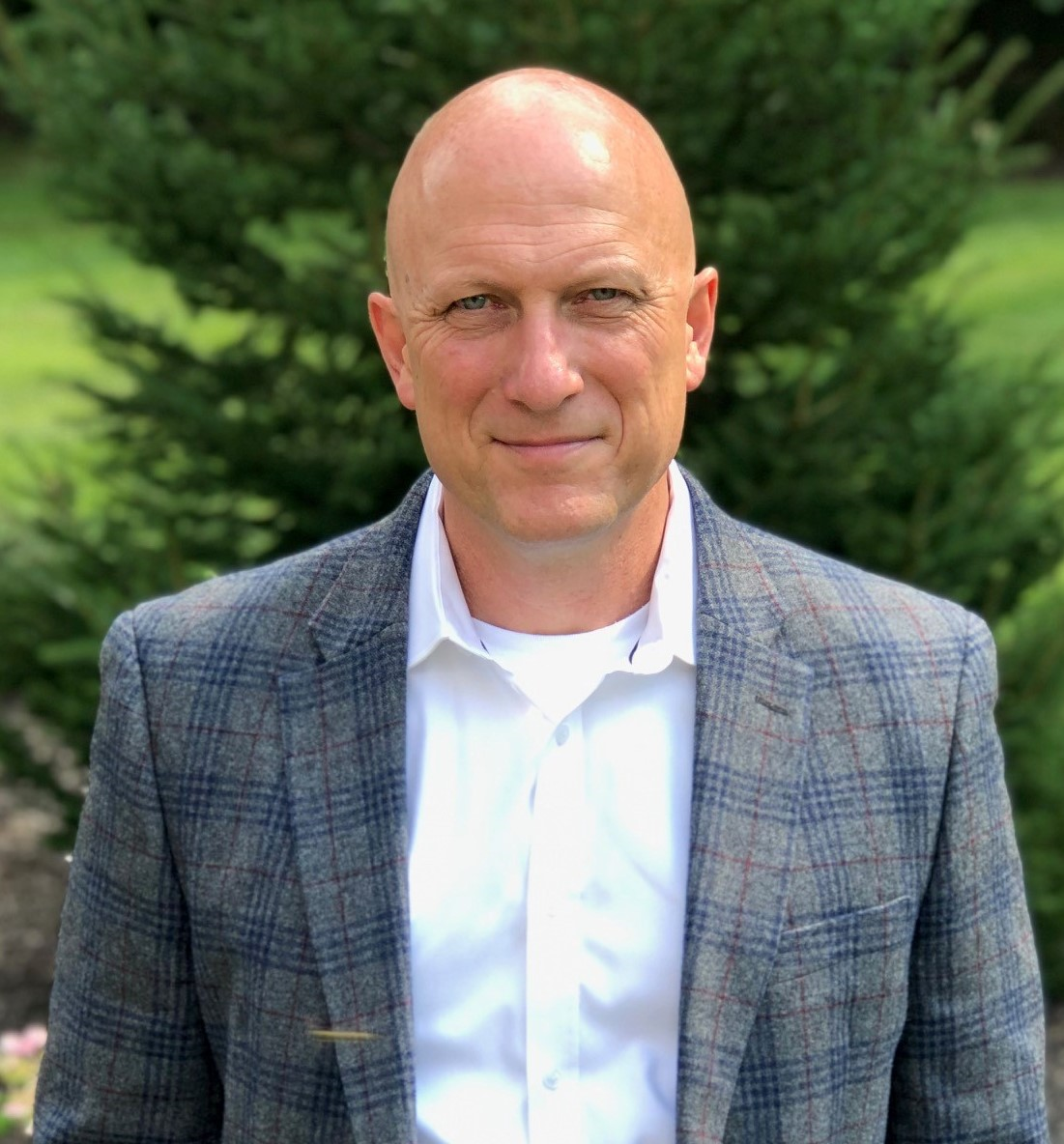
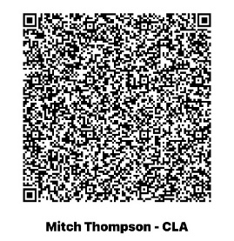
Introduction
Mitch Thompson
Digital Growth Director
Mitch.Thompson@CLAconnect.com
(317) 569-6154
Notes:
Mitch

Slide 146
Learning Objectives
At the end of the session, you will be able to:
• Identify how automation can improve operations

Slide 147
Key Objectives
Understanding the Basics of AI and Automation: Gain a comprehensive understanding of how AI and automation technologies work, specifically in the context of accounting and finance
Exploring Real-World Use Cases: Discover a range of practical use cases of AI and automation in financial processes
Benefits and Impact on Efficiency: Learn how implementing AI and automation can significantly improve efficiency, reduce errors, further organizational mission, and improve the lives of the workforce
Future Trends and Adaptation Strategies: Gain insights into how your organization can adapt and stay ahead in this rapidly evolving field, including strategies for implementation and overcoming potential challenges

Slide 148
Agenda
Understanding the Basics
Benefits
Use Cases
How to Implement
Future Trends
Demonstration of tools
Q & A

Slide 149
How Transformative Do You Believe AI Will Be?
Polling Question
A: I think it’s overhyped and unlikely to make much change.
B: Cautiously optimistic for how it will change how we work.
C: This is the fifth industrial revolution.
D: I don’t know enough to say but I want to know more.

Slide 150
Gartner Hype Cycle
Notes:
General then specific to Gen AI
Trigger: Release of ChatGPT in November 2022
Trough:
Slope: started entering last summer & fall w/Copilot

Slide 151
An Introduction Into Data, Automation, & AI
Notes:
Tell the story of how we got to where we are. Challenges in accounting, challenges inefficiency, challenges in accuracy, challenges in fraud, challenges in control. Quickly progressing, just like the rest of the world. Remember when you would not go to the cloud, that wasn’t that long ago.

Slide 152
Definitions
Data and Business Intelligence
Automation
AI & Generative AI
Large Language Models
Notes:
Set the foundation first.

Slide 153
Data & Business Intelligence
Data is the raw, unprocessed facts and statistics collected together for reference or analysis. In government, it is anything quantifiable and measurable, such as budget numbers, crime number, population demographics, and EMS statistics as examples. Data is the foundation to gain knowledge to make strategic decisions. Data is neutral and must be processed and analyzed to create value.
Business Intelligence are the tools, technologies and methodologies used to collect, integrate, analyze and present the data as business information. BI is to help make better decisions through the transformation of data into actionable knowledge. This is done through visualization, analysis, historical and predictive trending, and performance management.

Slide 154
Automation
Automation is the technique, method, or system of operating or controlling a process by highly automatic means reducing human intervention to a minimum. In Government environment this is seen in various reporting, integrating systems, computer vision and the implementation of large language models.
Notes:
What it is not. There is more than one AI model out there.

Slide 155
Manual Vs. Automated Reporting
A Comparison
Manual
Automated
80% of reporting is ad hoc, 20% standardized
80% standardized, 20% ad hoc
Time consuming
Time Saving
Prone to errors
More accurate
Inconsistent
Real time
Dependent on individuals
Scalable
Notes:
Also reduces risk of Fraud, save time and money

Slide 156
Example Of BI And Automation

Slide 157
What Is Artificial Intelligence?
AI is the ability of a computer, or a robot controlled by a computer, to do tasks that are usually done by humans because they require human intelligence and discernment
AI models are programs that analyze data sets and make predictions. AI modeling replicates human decision making and is more accurate and effective when it receives/trains on multiple data points
Types of AI
Automated Data Capture - AP Automation
Recommendation/Personalization - Amazon, Netflix, etc
Generative – content creating AI like ChatGPT
Anomaly Detection – fraud alerts
AI is a tool to supplement and augment daily functions to become more productive/helpful/resourceful

Slide 158
Comparing Traditional Computing Vs. AI
Traditional Computing: Set of explicit instructions for a specific task
Artificial Intelligence (AI): Machines learning and making decisions from data
Machine Learning
Deep Learning
Statistics
Artificial Intelligence
Machine Learning
Statistics
Deep Learning
Notes:
High level differences
Traditional computing is based on a set of explicit instructions given by a programmer to perform a specific task.
Example: A basic calculator program that adds two numbers is built using traditional computing.
AI encompasses systems that can learn from data and make decisions without being explicitly programmed for specific tasks.
The visual depicts the hierarchy of Artificial Intelligence (AI) domains:
Artificial Intelligence (AI): is the broadest field, encompassing the creation of machines that mimic human intelligence.
Machine Learning (ML): a subset of AI, focuses on algorithms that learn from data.
Deep Learning: nested within ML, delves into neural network-based algorithms for complex data tasks.
Statistics: overlaps with all areas, emphasizing its foundational role in data analysis and algorithm training across AI and ML.

Slide 159
What Is a Large Language Model?
LLMs are a specific type of AI focused on understanding, generating, and working with human language. They are trained on vast amount of text data to predict the next word in a sentence, understand context, answer questions and more.
Example is Generative Pre-trained Transformers (GPT) – focused on a particular set of content or material, for example your agency policies and procedures.

Slide 160
What Is GPT?
Goal of GPT project was to create chat agent that can interact conversationally, generate coherent, relevant content, answer follow up questions.
Trained on websites, books, and online material.
Humans AI trainers helped GPT models provide more desirable outputs via reinforcement learning.
OpenAI released ChatGPT November 2022
GPT is a kind of Large Language Model: Able to generate novel, human-like text, write code, and create datasets
Many updates and other new generative AI apps & services
Notes:
Powerful tool but it’s not perfect.
To understand how to get the most out of ChatGPT it helps to understand how it was trained.
Generative pre-trained transformer family of language models. “Large Language Models”
Goals include: interact conversationally, generate coherent, relevant content, and programming code, and answer follow up questions
1. Unsupervised Learning
Web sites, books, other documents used to train Language Model
2. Supervised Fine-Tuning
Human AI trainers provided conversations in which they played the user and the AI assistant
3. Reinforcement Learning from Human Feedback (RLHF)
Humans AI trainers helped GPT models provide desirable outputs.
Also mention plugins

Slide 161
GPTs
OpenAI
Other Organizations
ChatGPT 3.5
ChatGPT 4.5
Custom GPTs
Image generation
Academic research
Coding
Google Bard & Gemini
Facebook & Instagram Messenger
Snapchat AI Chatbot
Many research orgs & startups developing models & tools

Slide 162
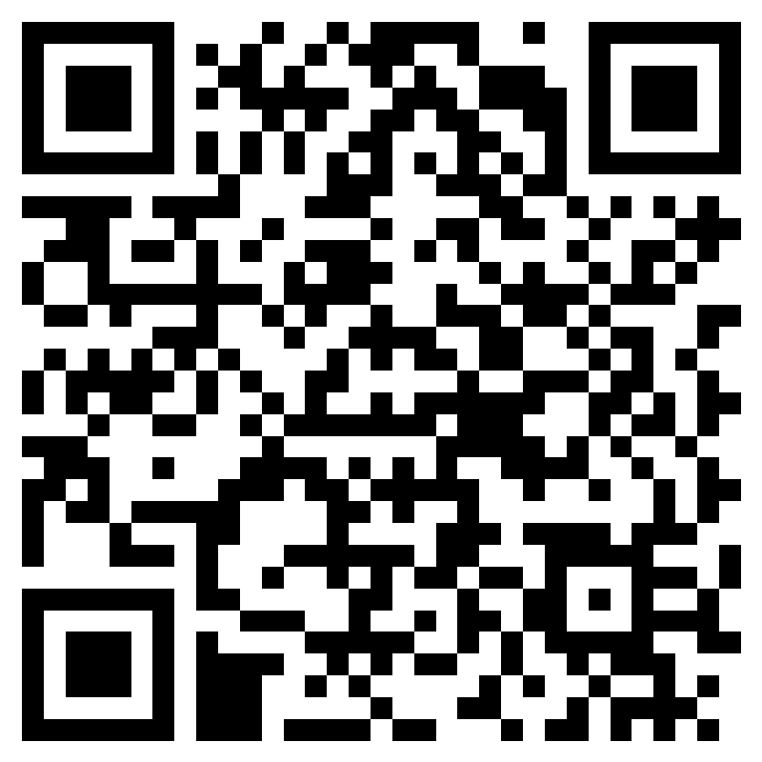
AI Today – Audience Participation
Can you give examples of AI in your daily personal or professional life today? Scan QR code and send answers!
Notes:
Go to Microsoft Forms ---- Social media – determining feeds and friend recommendations, Google search – rank, pull up most relevant content, Amazon rank and product descriptions, Bank credit card alerts, Adobe – scanning docs using OCR, iRobot vacuum, Zoom meeting closed captioning, etc.

Slide 163
Time Magazine 2011
Notes:
Note the 2023 prediction of exceeding the brainpower of a human

Slide 164
Benefits And Impact
Improve Efficiency
Improve Accuracy
Improve Organizational Capabilities
Improve Employee Satisfaction
Notes:
Maybe solicit audience feedback too

Slide 165
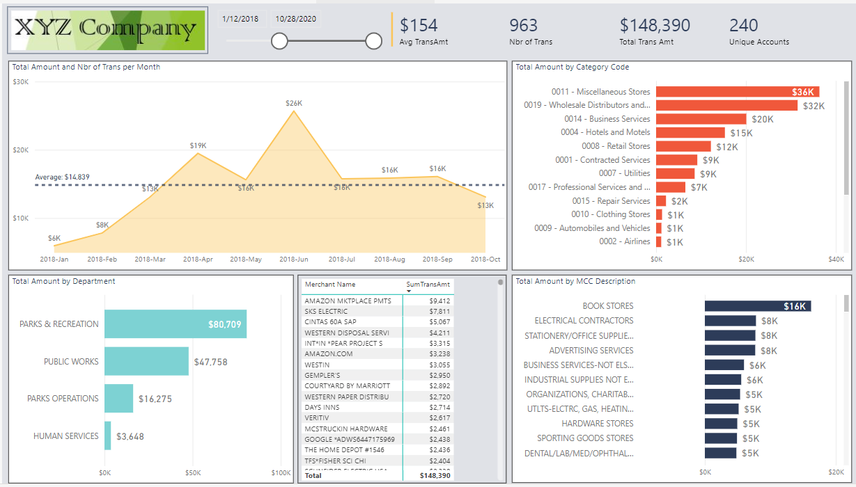
Use Case Study: Business Intelligence Reporting and Automation – P Card Analytics
Notes:
Screen shot of P Card Analytics

Slide 166
Use Case Study: AP Automation
Spreadsheet
Reduce manual data entry from documents such as invoices
Minimize error associated with manual processing
Integrate with existing workflow and enterprise systems
Invoice from Vendor
Extract Data
Human Review
QuickBooks & Other Finance Systems
Uploaded Invoice
Reduction in manual invoice processing time
Data Lake, Warehouse, Lakehouse
Notes:
Use computer vision, deploy personnel to other higher value roles.
Could quickly demo auto extract

Slide 167
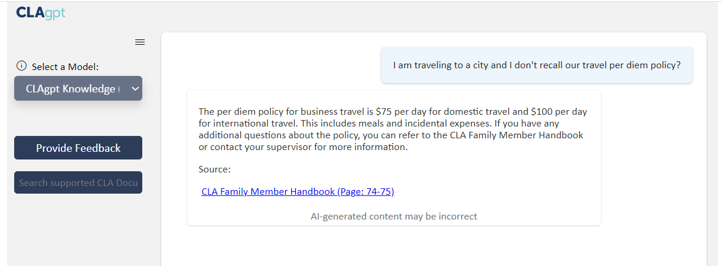
Use Case Study: Large Language Models
Notes:
For compliance, for customer service, for audit
Could demo CLAgpt, or GPT 4.0
Each case study could include a problem statement, the AI/automation solution implemented, and the results achieved

Slide 168
Use Case Study: Microsoft's Copilots
Windows Copilot
Microsoft 365 Copilot
GitHub
Other copilots
Power Platform
Microsoft Fabric
Azure AI
Dynamics 365
And more!
Notes:
Mitch – Demo as well
Microsoft Copilot
Microsoft 365: Offers AI-enhanced features in its suite of applications like Word, Excel, and Outlook.
Power Apps Ideas: Uses AI to help users create apps by translating natural language descriptions into formulas.
GitHub Copilot X
Code completion: Suggests whole lines or blocks of code as developers type.
Code documentation: Assists in generating documentation comments based on the function or method.
Learning new languages: Helps developers get acquainted with syntax and libraries in unfamiliar programming languages.
Azure AI Copilot
Azure Machine Learning: Provides tools for building, training, and deploying machine learning models.
Azure Cognitive Services: Offers APIs for vision, speech, language, and decision-making capabilities.
Azure Bot Service: Enables the creation of intelligent chatbots.
Dynamics – various functions

Slide 169
Challenges
Data accuracy
Bias
Security
Trust but Verify
Know the source
Fear of use of available tools
Notes:
Key is how the AI model provides context in the answer
No “One God”, but many AI tools that specialize in fields. Much like humans

Slide 170
Overcoming Challenges
Be intentional on how AI can provide the most benefit
Controls – keep a human in the loop, and trust but verify
Limited, controlled roll out. Pilot first
Security of infrastructure
LLM versus OpenAI

Slide 171
How To Get There
Assess current state
Data readiness
Develop a roadmap
Short term and long-term objectives
Internal working group
Test the technology
Educate yourself!
Notes:
Low hanging fruit – high impact, low effort. Govt. takes time bc of budgeting cycles, establish a short and long term plan

Slide 172
Future Trends
It’s not going away
Speed of growth will continue to expedite
Controls?
There will be many models to choose from
The use cases will become endless
Notes:
Key is how the AI model provides context in the answer
No “One God”, but many AI tools that specialize in fields. Much like humans

Slide 173
Question and Answer Session

Slide 174
Thank You!
Mitch Thompson
Digital Growth Director
Mitch.Thompson@CLAconnect.com
(317) 569-6154
Notes:
Mitch

Slide 175
45 Minute Lunch Break
11:45 a.m. – 12:30 p.m.

Slide 176
PERA Pension Update
Doug Anderson, ASA, MAAA, Executive Director
March 1, 2024

Slide 178
Learning Objective
At the end of the session, you will be able to:
•Recognize the status of public pensions in Minnesota

Slide 184
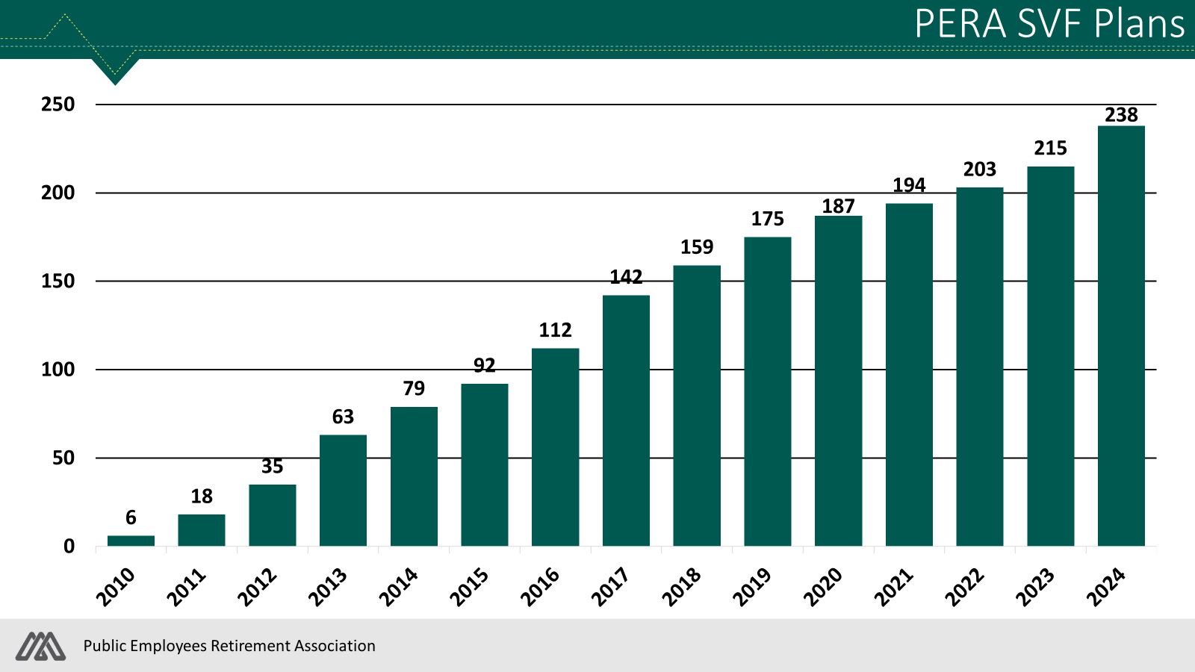

Slide 217
Economic And Market Update

Slide 218
Disclosures
CliftonLarsonAllen Wealth Advisors, LLC (“CLA Wealth Advisors”) The purpose of this publication is purely educational and informational. It is not intended to promote any product or service and should not be relied on for accounting, legal, tax, or investment advice. The views expressed are those of CLA Wealth Advisors. They are subject to change at any time. Past performance does not imply or guarantee future results. Investing entails risks, including possible loss of principal. Diversification cannot assure a profit or guarantee against a loss. Investing involves other forms of risk that are not described here. For that reason, you should contact an investment professional before acting on any information in this publication. Financial information is from third-party sources. Such information is believed to be reliable but is not verified or guaranteed. Performances from any indices in this report are presented without factoring fees or charges and are provided for reference and competitive purposes only. Any fees, charges, or holdings different than the indices will affect individual results. Indexes are unmanaged; one cannot invest directly into an index. Investment Advisory Services offered through CliftonLarsonAllen Wealth Advisors, LLC, an SEC Registered Investment Advisor. Prior approval is required for further distribution of this material.

Slide 219
Agenda
Economic Update
Market Intel
Election Year
Timing and Diversification

Slide 220
Learning Objective
At the end of the session, you will be able to:
Review current economic trends

Slide 221
Economic Update

Slide 222
Current Market Sentiment
Source: CNN Business

Slide 223
Sentiment And Returns

Slide 224
Unemployment Rate

Slide 225
Gross Domestic Product

Slide 226
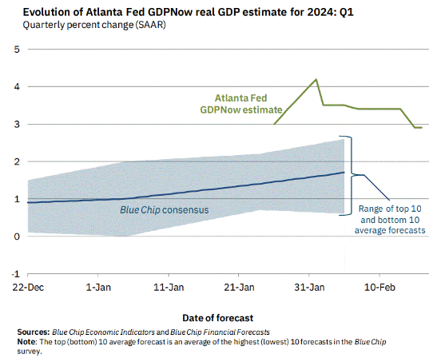
Current GDP Estimates

Slide 227
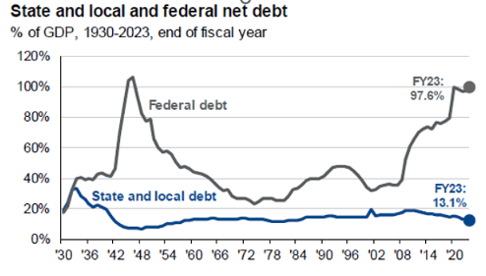
Defaults And Debt

Slide 228
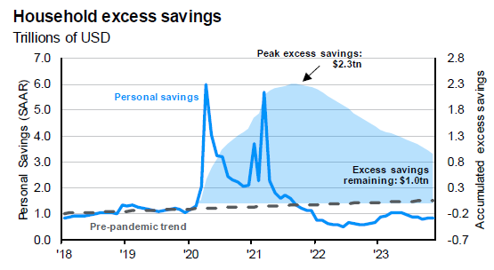
Cash Flowing

Slide 229
Extreme Data Swings Continue To Renormalize

Slide 230
Rising Interest Costs Affect Governments And Businesses

Slide 231
Geopolitics

Slide 232
Fed Funds Rate Probabilities
Source: CME FedWatch Tool - CME Group as of 2/16/24

Slide 233
Market Intel

Slide 234
US Recession That Never Was
Source: Bloomberg, April 2023

Slide 235
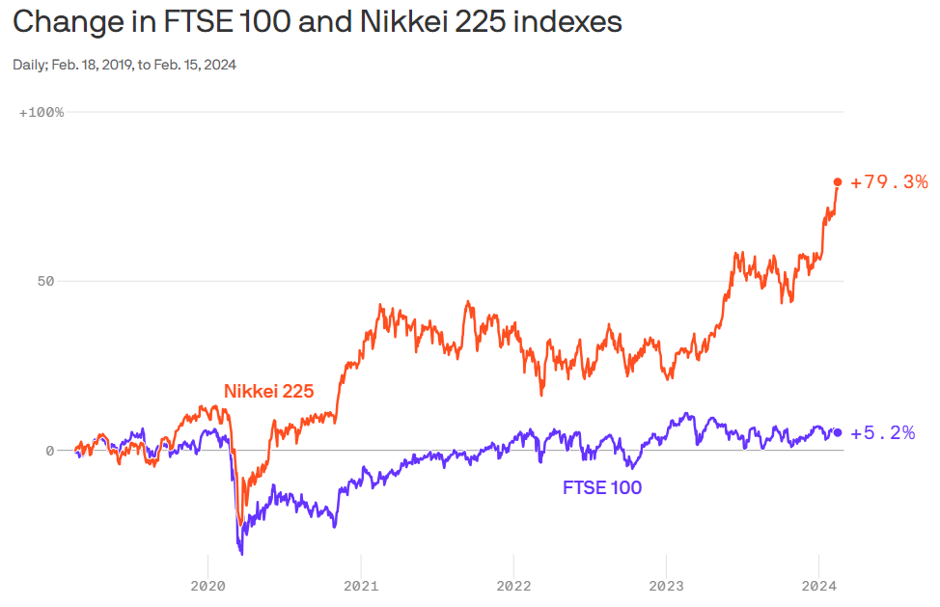
UK / Japan Recession
Source: Data: Yahoo Finance; Chart: Axios Visuals

Slide 236
Intra-Year Declines And Annual Returns

Slide 237
Magnificent 7

Slide 238
Magnificent 7 (Euro Edition)

Slide 239
Across The Pond And Beyond

Slide 240
Impact Of Rates On Bond Prices

Slide 241
Second Look At Cash

Slide 242
Election Year

Slide 243
What’s At Stake For 2024 Presidential Election
Source: CLA

Slide 244
Markets And Divided Government

Slide 245
January Calling

Slide 246
Past Election Year Volatility

Slide 247
Election Year Rates

Slide 248
Time – In The Market

Slide 249
Timing and Diversification

Slide 250
Diversification Does Not Always Feel So Good…

Slide 251
Asset Class Returns 2009-2023

Slide 252
Time & Volatility Of Returns

Slide 253
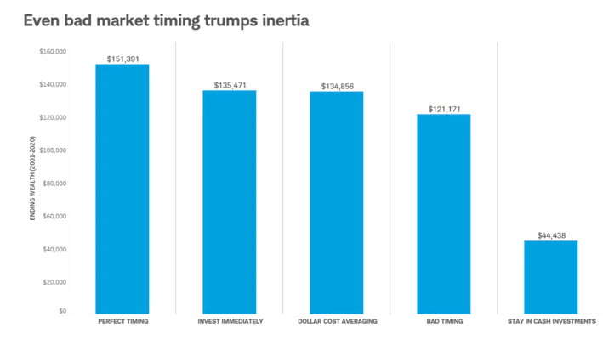
Timing The Market
$2,000 invested annually in a hypothetical portfolio that tracks the S&P 500® Index from 2001-2020. The individual who never bought stocks in the example invested in a hypothetical portfolio that tracks the Ibbotson U.S. 30-day Treasury Bill Index. Past performance is no guarantee of future results.
Source: Does Market Timing Work? | Charles Schwab
Buys at lowest price every year
Buys Jan. 1
Buys 1st of every month
Buys at highest price every year
Stays in money market (cash)

Slide 254
Takeaways For 2024
US Economy Return to Normalization and Maintaining Growth In a Higher Interest Rate Environment
Presidential Election – The Market Likes a Divided Government
Difficult to Time the Market – Stay Invested and Diversified

Slide 255
Nathan L. Woessner, CFP® CliftonLarsonAllen Wealth Advisors LLC
Nate.Woessner@CLAconnect.com 612-376-4792
Peter Holupchinski, CFA, CPA, CFP® CliftonLarsonAllen Wealth Advisors LLC
Peter.Holupchinski@CLAconnect.com
612-397-3243

Slide 256
Social Engineering – How Deception And Manipulation Lead To A Cyber Breach

Slide 257
Learning Objective:
At the end of the session, you will be able to:
Recognize how social engineering affects organizations and how to defend against common attack methods

Slide 258
Today’s Presenter
RJ Stallkamp | OSCP CLA (CliftonLarsonAllen LLP)
Holder of 3 CVE’s (Patented Exploits)
Hacking Tool Developer
Self Taught Hacker
Social Engineering Specialist

Slide 259
What is Social Engineering?
Sun Zhu - The Art of War – “Know Thy Enemy”
At the end of the session, you will be able to: Recognize how social engineering affects organizations and how to defend against common attack methods

Slide 260
Current State Of Cybercrime
Hackers have monetized their activity
Theft of personally identifiable information (PII)
Payment fraud
Ransomware/Information Warfare
Most attacks are carried out by organized crime rather than lone wolves

Slide 261
Organized Crime
Hacking is run like a business where people specialize in different areas
Writing malware
Renting botnets
Stealing data
Selling data
(Collect data from various sources/BIG DATA)
Most attacks are completely automated

Slide 262
Theft Of PII (Personally Identifiable Information)
All this information has value
Submit fraudulent tax returns
Submit fraudulent insurance claims
Set up fraudulent identities for credit
Purchase items with stolen credit card information
Use emails for phishing campaigns
Attackers buy and sell data on the black market
Similar to Amazon.com for stolen information

Slide 263
Marketplace For Stolen Credit Cards

Slide 264
Understanding the Human Element

Slide 265
Baseline Human Flaws
Cognitive biases
Need for acceptance
FOMO
The 3 “mental lives”
Public
Private
Secret

Slide 266
The Power Of Persuasion
Control how you’re perceived
Body Language
Cadence of Speech
Clothing
Appearance
Influence the target
Reciprocity
Authority
Social Proof
Scarcity
Fear

Slide 267
The “DARVO” Principle
Deny
Attack
Reverse
Victim
Denial/Gaslight
Overt and covert attacks against victim
Attacker claims they are the victim (role switching)
Attacker continues to play the victim, or victim blame

Slide 268
Anatomy Of A Social Engineering Attack
Recon
Internet-facing infrastructure
Employees via social media (LinkedIn)
Available breach data/credentials
Craft Scenario
Gift card request
Sexual Harassment Complaint
Dress Code Policy
Bonus $$$
Attack
Capture Credentials
Deliver a malicious remote access file
Access online resources
Disrupt Operations
Exfiltrate data
Deploy Ransomware
Harvest Intellectual Property

Slide 269
Case Studies Of Social Engineering Mastery
Kevin Mitnick
Mark Rifkin
Impersonated company employees via “pre-texting”
Breached Motorola, Novell, Nokia in the 1980’s and 1990’s
Never profited from his exploits
After his arrest in 1995, he was placed in solitary confinement due to a rumor that he could cause nuclear war by whistling into a pay phone
Co-Founder of “KnowBe4”
Computer repair consultant in the 1970’s
Visited Pacific Security bank’s wire transfer room and memorized the daily transfer security code
Called bank’s transfer dept, impersonated an employee, and had $10.2m wired to a private Swiss bank account

Slide 271
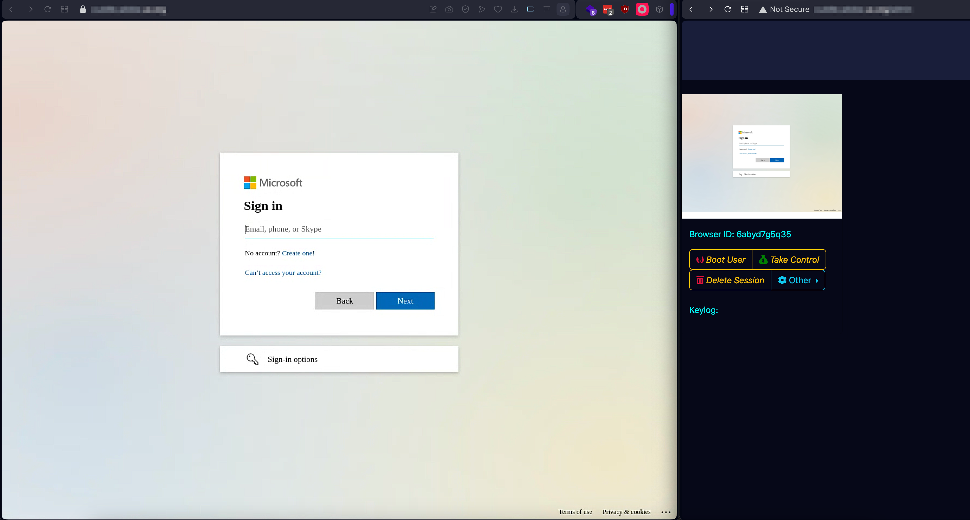
Email Phishing
Victim
Attacker

Slide 272
Protecting Against Social Engineering
It is not a matter of IF…
It is a matter of WHEN…

Slide 273
Don’t Be DUPED
Deploy Multi-Factor Authentication (MFA)
Update your software regularly
Passwords – At least 14 characters
Enforce Security Awareness Training
Don’t click on things you shouldn’t

Slide 274
Strategies
Our information security strategy should have the following objectives:
Assume breach mentality
Defense in-depth – protect the crown jewels
Users that are aware and savvy
Networks that are hardened and resistant to malware and attacks
Resilience capabilities: Monitoring, incident response, testing, and validation
All of the above is supported by regular/periodic risk assessment

Slide 275
Assume Breach Approach
“Assume breach” limits the trust placed in applications, services, identities, and networks by treating them all, both internal and external, as not secure and possibly already compromised.

Slide 276
Approach Comparison
Prevent Breach
Assume Breach
Firewall / Perimeter
Static Defense
“Set and Forget”
Code Review
Antivirus
Threat Modeling
Constant Monitoring
Logical Defense
Awareness
Testing
Continual Improvement
Red Team Simulation

Slide 277
Security Evolution
Prepare for an “inevitable” breach
Build and maintain robust, repeatable, and thoroughly tested security response procedures (playbook)
Understand what normal looks like and constantly monitor for presence of abnormal

Slide 278
Fire Department/Team Paradigm
We do not expect firefighters to learn how to fight a fire when we call them!
We should NOT expect our IT staff to handle incidents without training or proper tools.
Concepts
Specialized gear
Specialized training
Tools are tested
Simple repeatable tasks
Fast response is expected
Communicate effectively

Slide 279
Questions?
Fun Social Engineering Tricks for Everyone
Got pulled over by the cops?
Keep a “get out of jail free” Monopoly card in your vehicle and give to the officer. Making a cop laugh within the first 15 seconds can mean the difference between getting a ticket, or not.
Don’t want to hold on to an item?
Start a conversation with your children, spouse, anyone, and slowly hand them the item during the conversation. They WILL take it without questioning why.

Slide 280
Thank you!
RJ Stallkamp | OSCP
Senior Penetration Tester
Rick.Stalkamp@CLAconnect.com
612-397-3247

Slide 281
It takes balance.TM
It’s our job to engage in conversations, listen to what you really want, and apply our talents and experience to make extraordinary impact on your organization and life.

